Slide 1
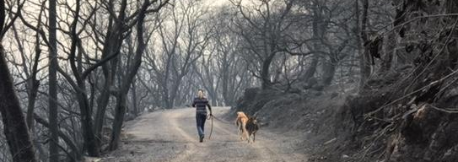
Napa Community Animal Response Team
Volunteer Training in Animal Disaster Response
Saturday, February 1, 2020

Slide 2
Napa Community Animal Response Team
Preparedness Training ● Emergency Response ● Recovery & Support
Our Mission
Educate the public on the animal component of disaster preparedness, response and recovery
Assist Emergency Services in sheltering, evacuation and care of animals during a disaster
Provide ongoing training in the animal component of emergency and disaster response to first responders and community volunteers
Create a reserve of Disaster Service Workers
Notes:
Mission - Claudia

Slide 3
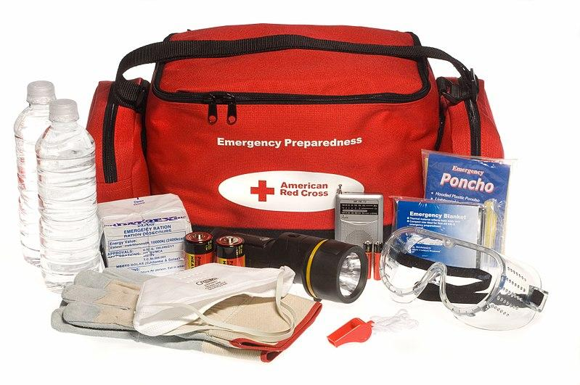
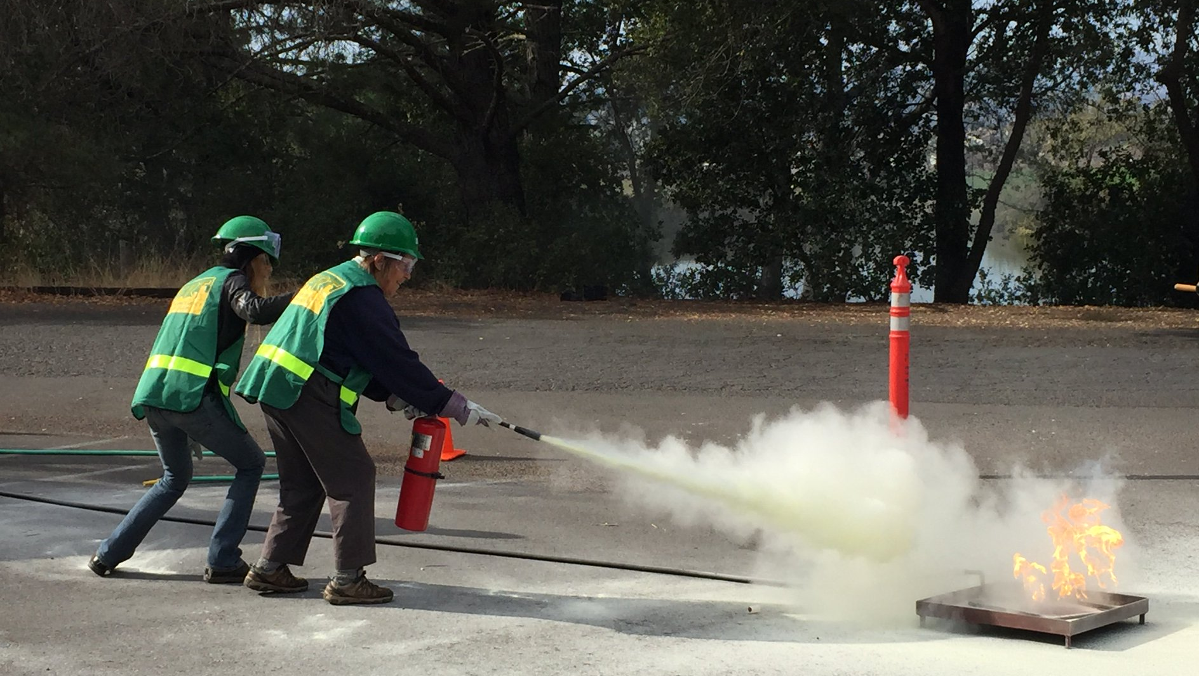
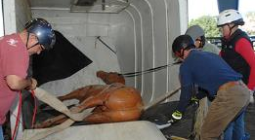
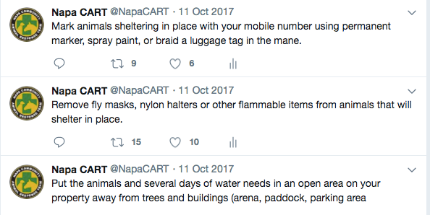
Public Education
Monthly preparedness training - See 2020 schedule
CERT course sponsorship - sign up
Community Volunteer certifications
Alerts and PSAs via Social Media
  FB & Twitter @napacart
  Instagram @napa.cart
  FB Group: Napa CART Group
First Responder Training
Notes:
Public Education - Claudia

Slide 4





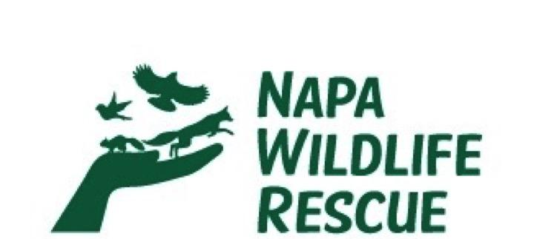


Community Advisory Board
Notes:
Community Advisory Board - Claudia
Napa Humane, Napa County Sheriff, Napa County Animal Shelter, Napa Wildlife Rescue, Sunrise Horse Rescue, Jameson Animal Rescue Ranch, Whiskers, Tails & Ferals, Wine Country Animal Lovers, We Care Animal Rescue

Slide 5



Shelter Collaboration
Notes:
Shelter Collaboration - Claudia

Slide 6
Incident Command System ICS
Developed in California in 1970s to facilitate multi agency response to wildfires
Internationally used in emergency response
Essential language of first and second responders to integrate/work together
FEMA ICS 100, 200 are required
How does this translate to you as volunteers?
  Report to a supervisor
  Span of control
  Follow procedures- you are not in charge….
Notes:
ICS - Claudia

Slide 7
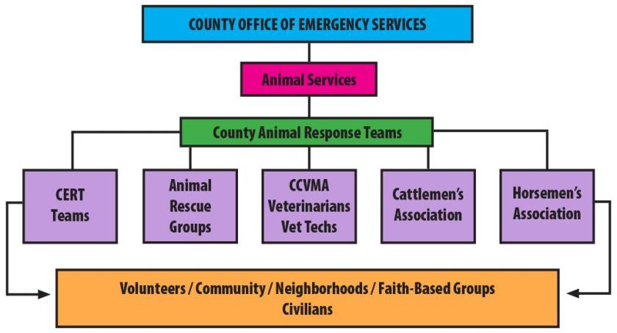
Example of ICS Organization
Notes:
ICS - Claudia

Slide 8
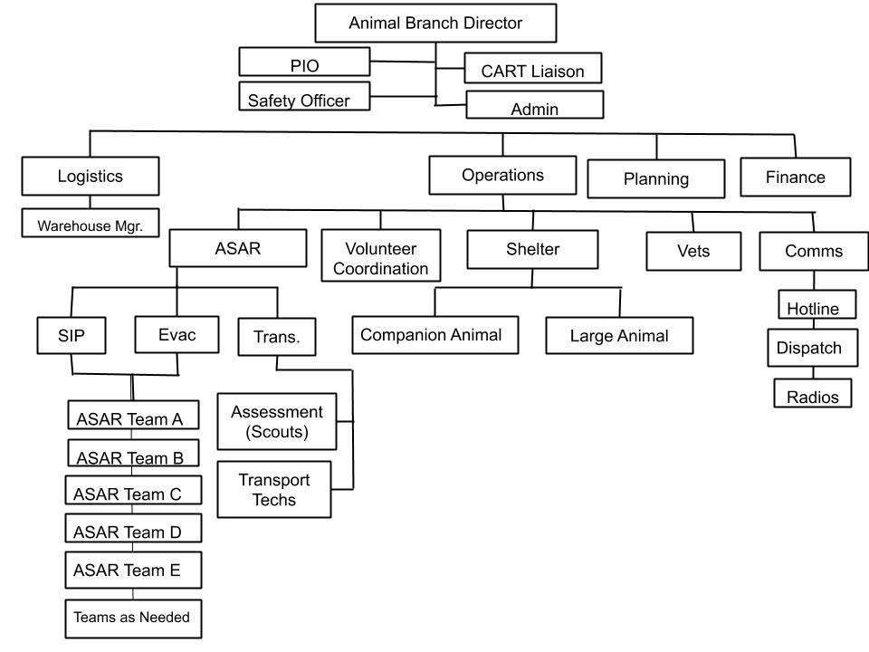
NapaCART ICS Chart
Notes:
ICS - Claudia

Slide 9

Lessons from Valley Fire
76,000 acre fire in 2015
Local officials were overwhelmed with the human element and response
Realized an organized and integrated approach to the animal component of disaster response was needed
Napa CART formed in 2017, guided by UC Davis IAWTI, NVADG & BARTA
Notes:
Valley Fire - Claudia

Slide 10
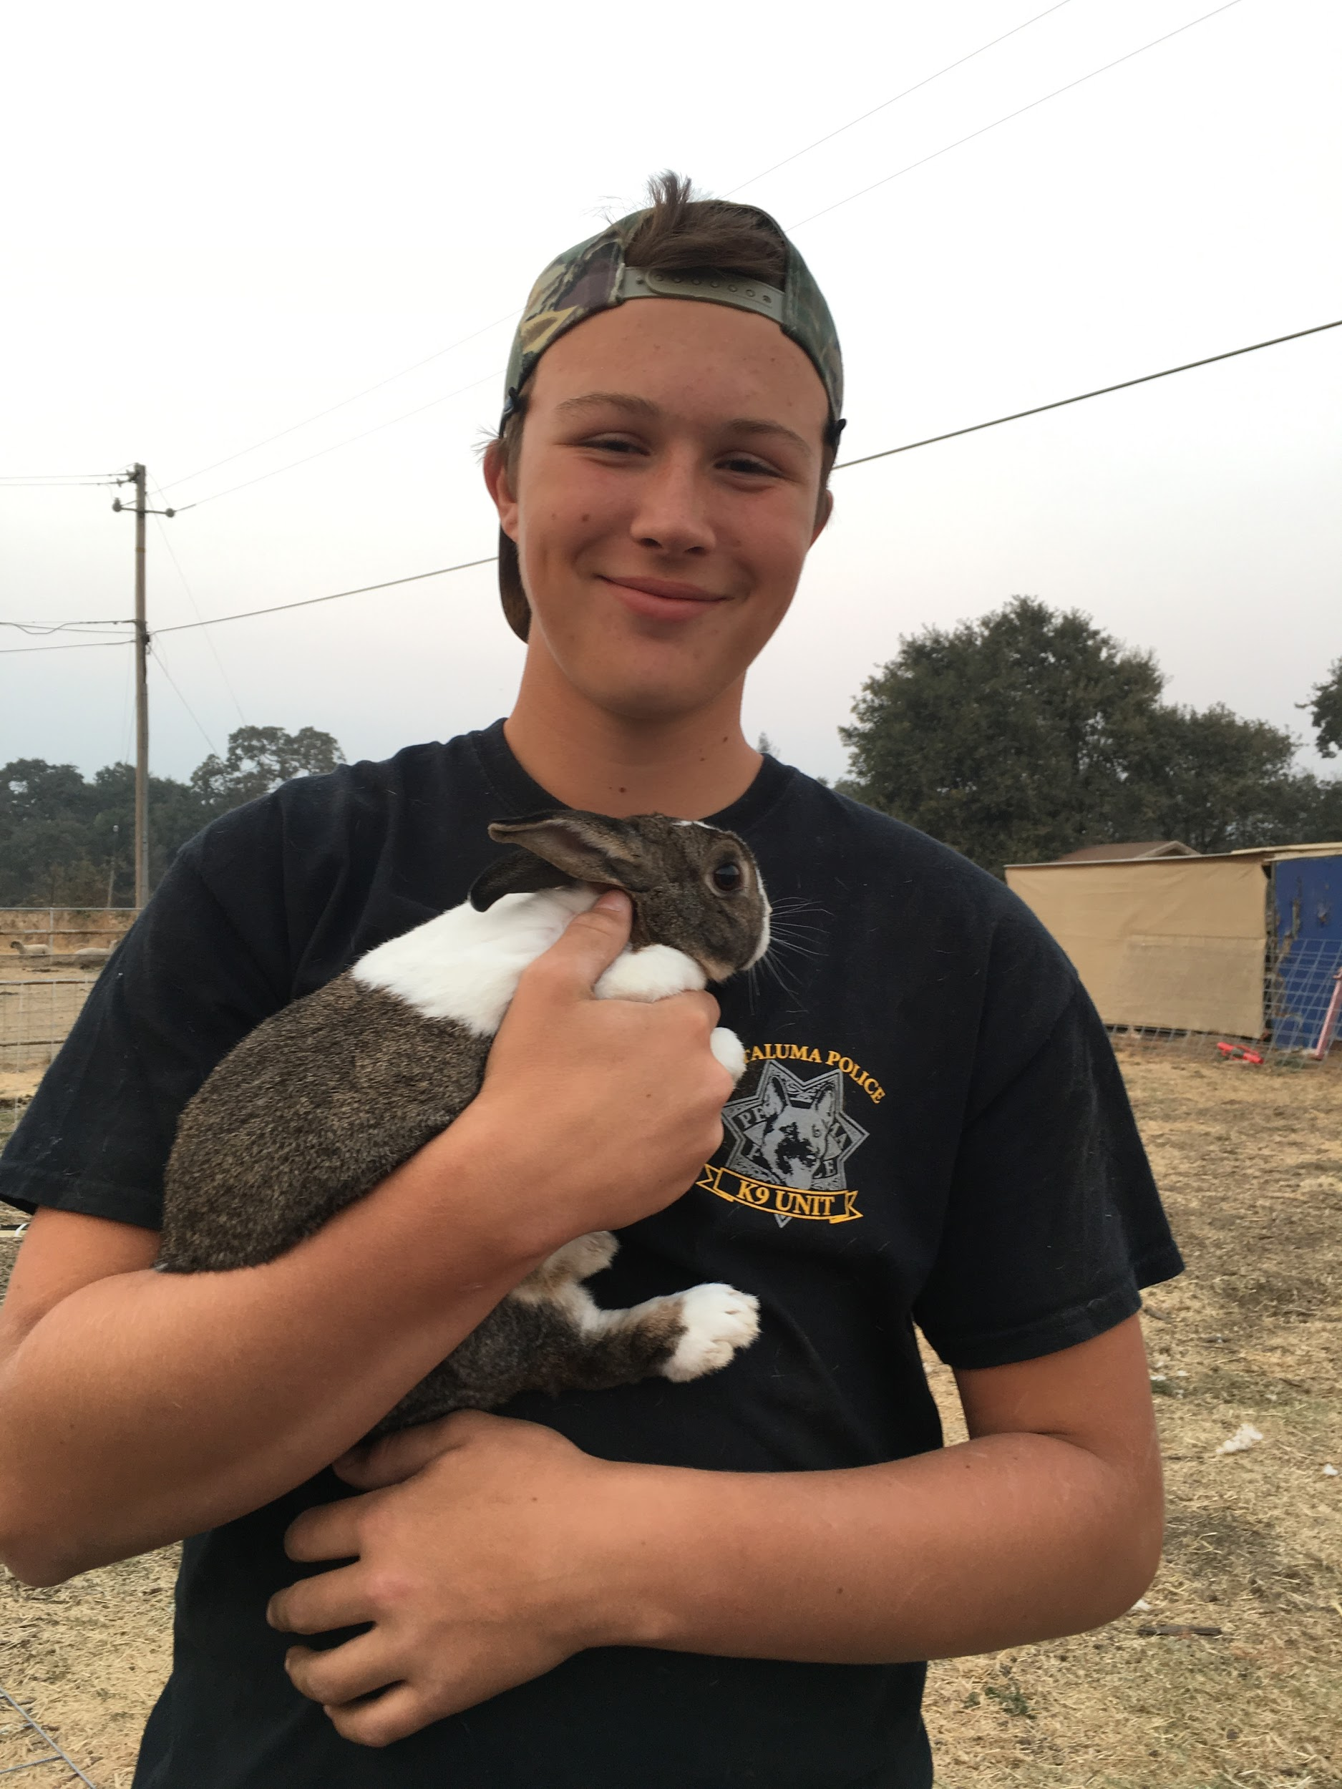
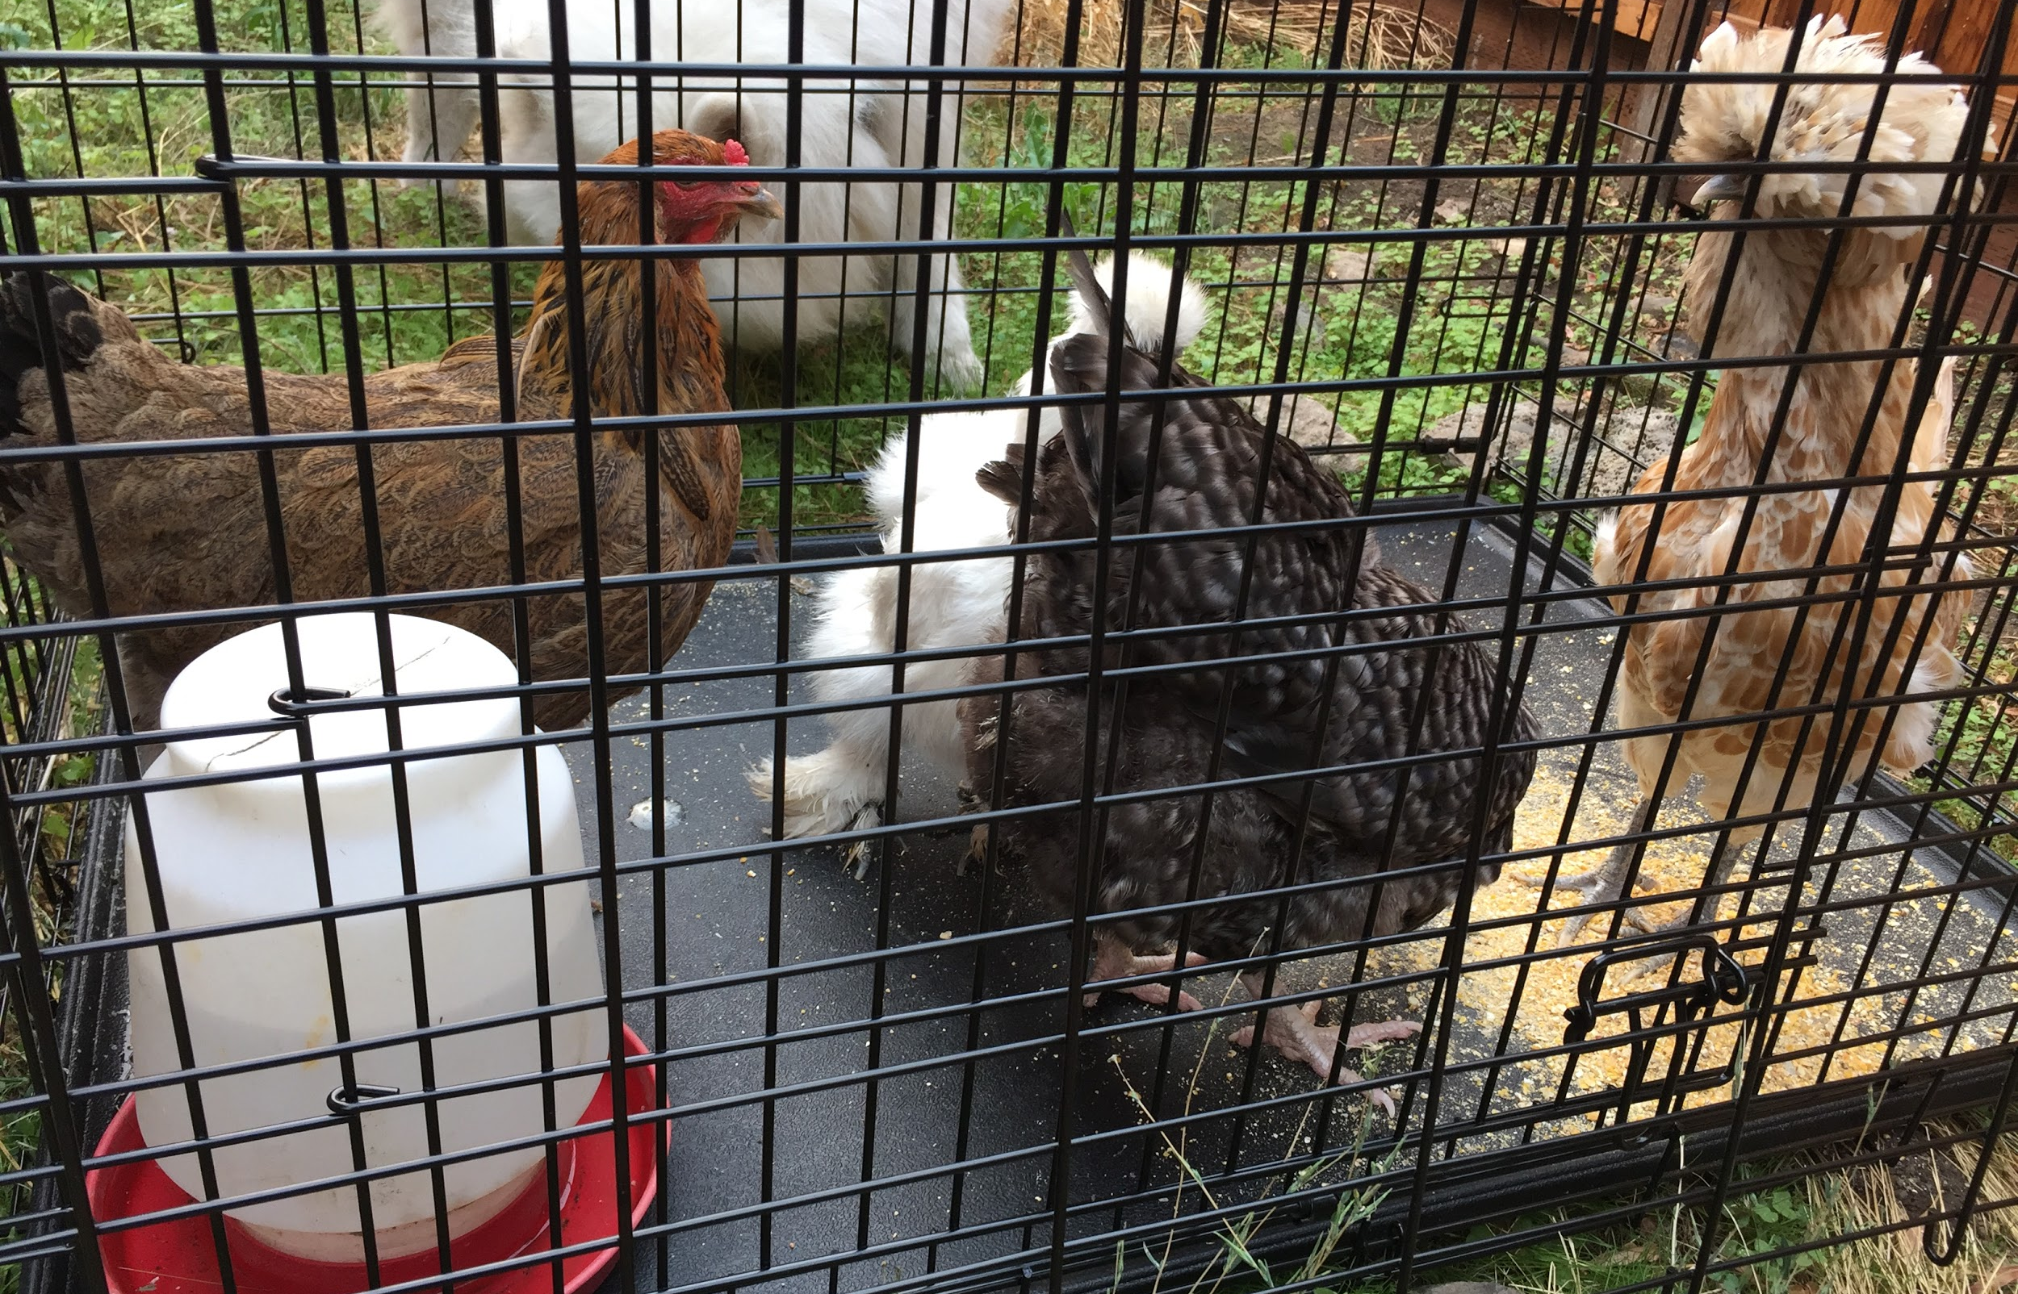
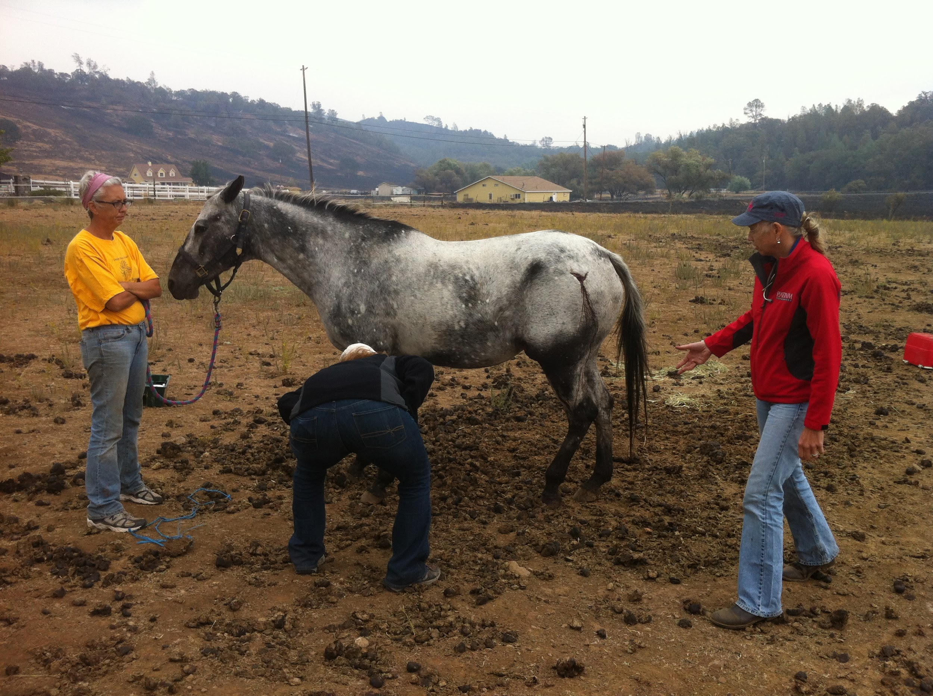
Helping Animals During a Disaster Helps People
Increases compliance with evacuation advisories/orders
Increases compliance with First Responder barricades (desperate people will otherwise try to sneak back in to affected areas to get their animals)
Makes a huge difference in disaster victims’ ability to recover from the disaster
When individuals recover - communities recover
Healing power of the Human-Animal Bond
Notes:
Previous deployments - Claudia
Healing power of the human -animal bond

Slide 11
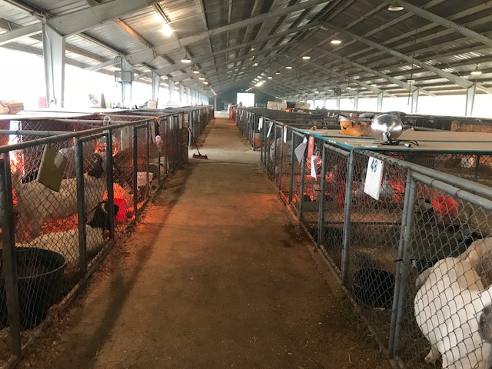
Previous Responses
2015
Valley Fire - Lake County
2017
Canyon Fire - Napa County
(Berryessa/Capell)
Central Complex Fires-
Napa County
2018 - June 23 - Nov 28
County Fire, Snell Fire - Napa County
Pawnee Fire, Mendocino Complex (River & Ranch Fires) - Lake County
Camp Fire - Butte County
2019 - Kincade Fire
Notes:
Previous Deployments - Claudia
We are young and evolving. We value experience and learn from other orgs around us.

Slide 12
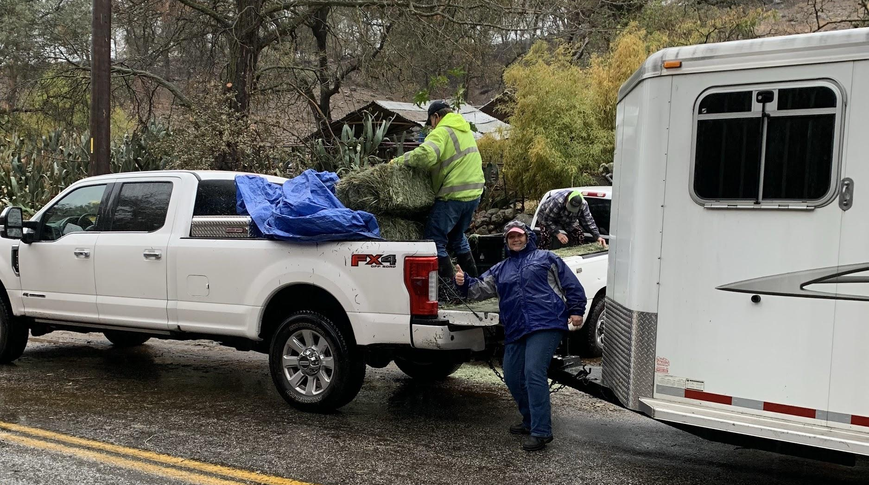
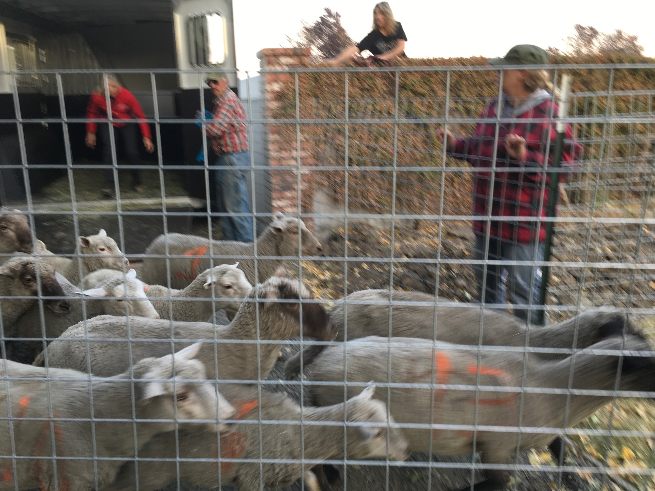
Types of Assistance
Livestock shelter
SA shelter
Volunteer scheduling
Donation management
Animal Transportation
Communications
Hotline/Dispatch assist
Supply delivery
Foster homes
Notes:
Previous Deployments - Claudia

Slide 13
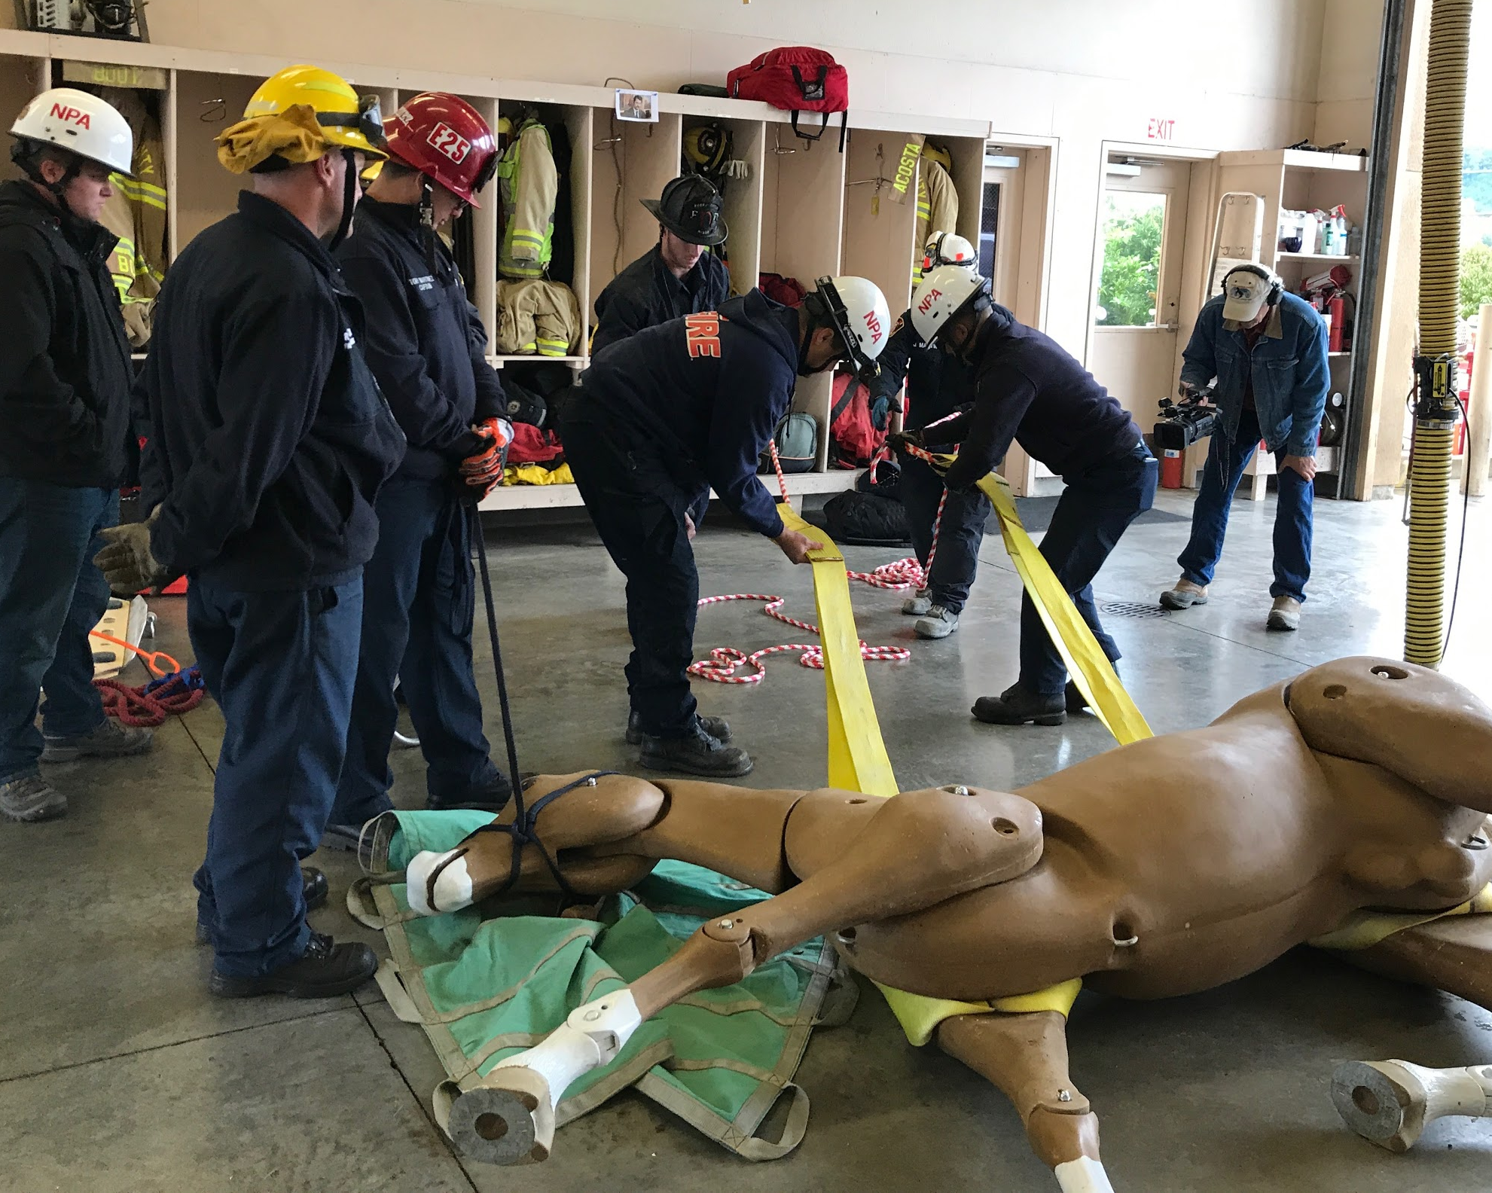
County Updates
Post Oct. 2017 recommendations incorporated into County Emergency Action Plan
Signed MOU
Integrated with County
Communications and
Dispatch
Acquired shelter
equipment to set up
rapidly in designated
and non-designated sites
Background checks
Badges

Slide 14
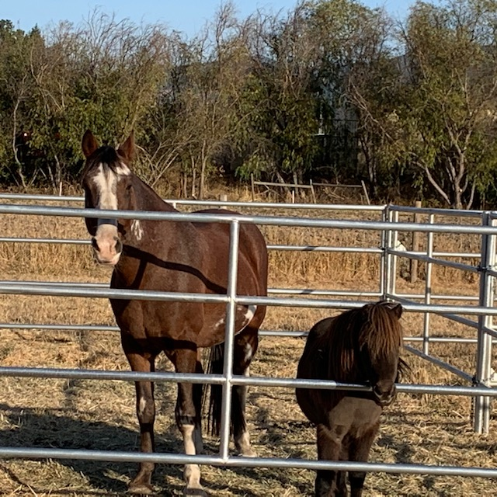
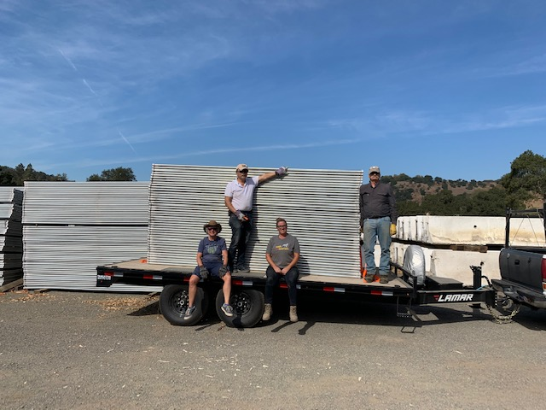
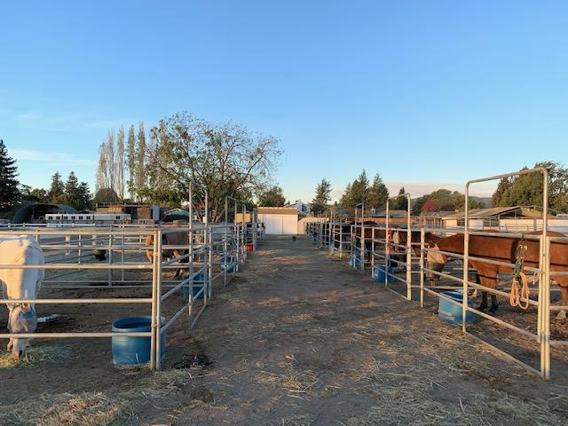
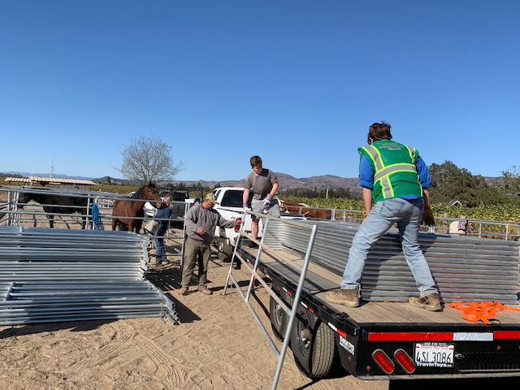

Slide 15
2
Leadership
3
Dispatch & Comms
Trailer Operator
1
Pilot/Supply Car Driver
Disaster Service Worker
Livestock Shelter
SIP, Animal Handler, Scribe
Small Animal Shelter
Animal SAR
Radio Operator
Notes:
Training tracks - Megan

Slide 16
Certified Animal Disaster Service Worker
Napa CART Volunteer Training in Animal Disaster Response
Signed Napa CART Volunteer Liability Release Form
CERT training certification: www.countyofnapa.org/2478/Training-Opportunities
FEMA Online Courses: training.fema.gov/is/crslist.aspx
  FEMA IS-100 - Intro to Incident Command System
  FEMA IS-200 - ICS for Single Resources and Initial Action Incidents
Background Check - Sterling Volunteers
Upon completion of any of the above or any other pertinent training, email certificates to volunteer@napacart.org
Notes:
Training Tracks - Megan

Slide 17
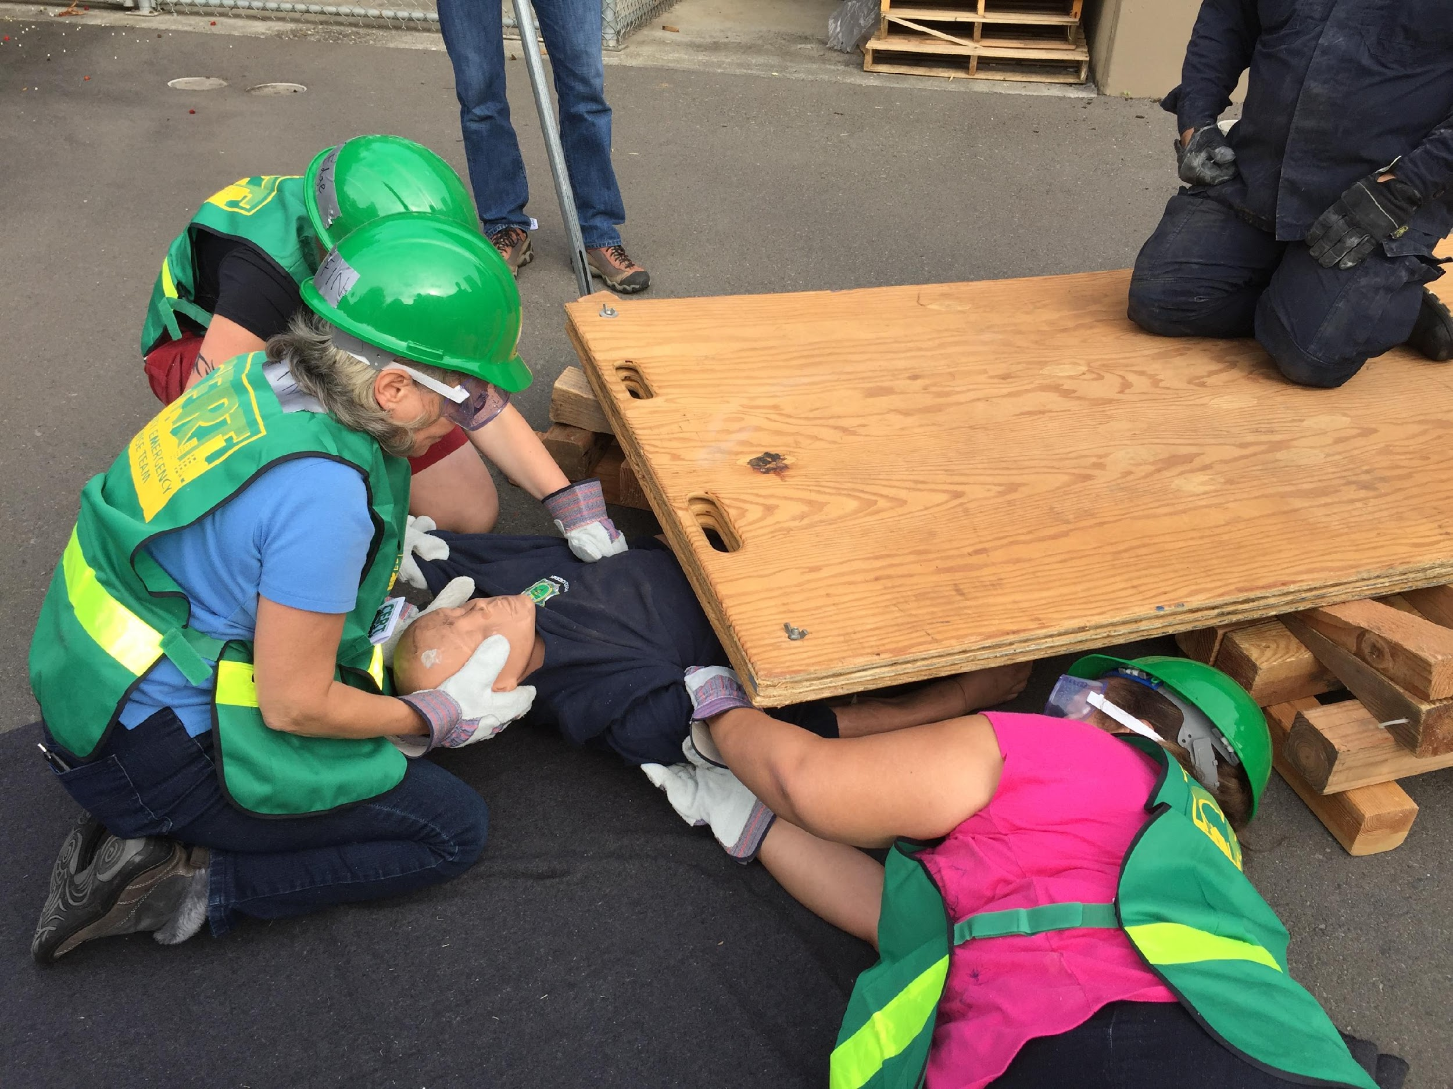
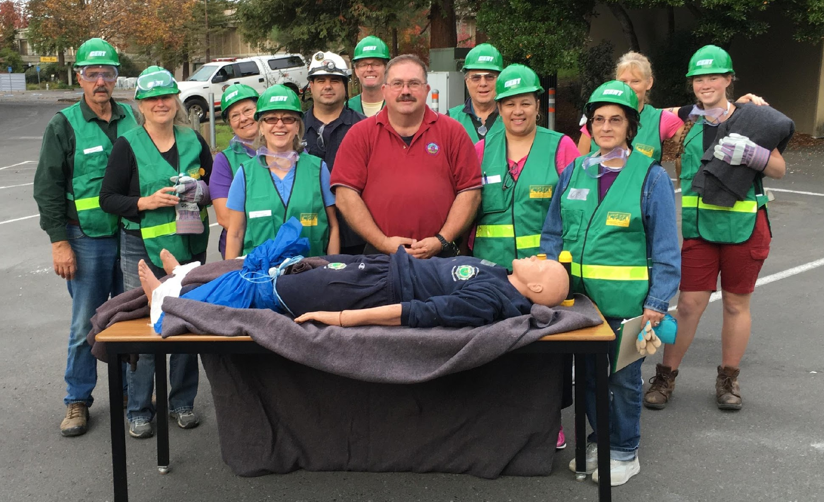
CERT Training
Community Emergency Response Team (CERT) teaches disaster response skills, light search and rescue, team organization, personal preparedness and disaster medical operations
Napa CART is animal equivalent of CERT - CARTs include CERT activities with a focus on animals
Notes:
Training Tracks - Megan
A national program of citizen disaster training

Slide 18
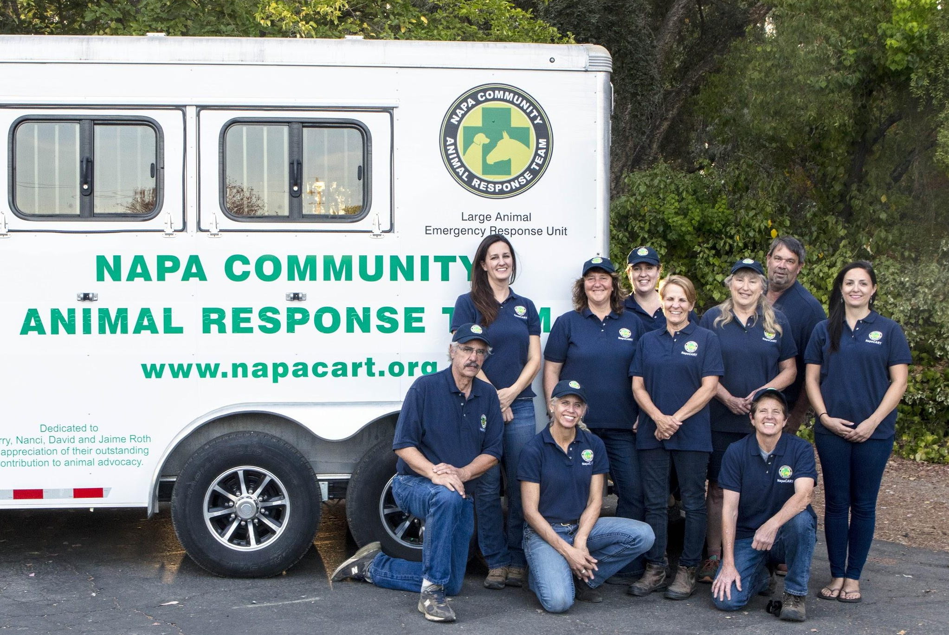
Leadership Roles
FEMA IS-700.b Online Course
FEMA IS-800.c Online Course
Notes:
Training Tracks - Megan

Slide 19
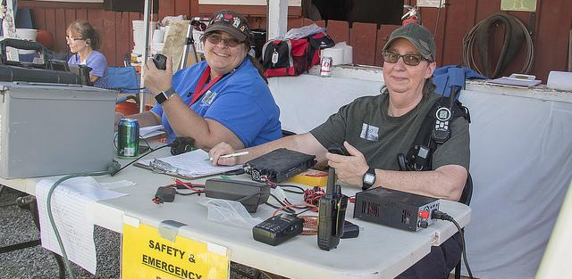
Dispatch & Communications
Dispatch Training - June 6, 2020
Communications Training - August 1, 2020
FEMA IS-144 Online Course (recommended)
Notes:
Training Tracks - Megan

Slide 20
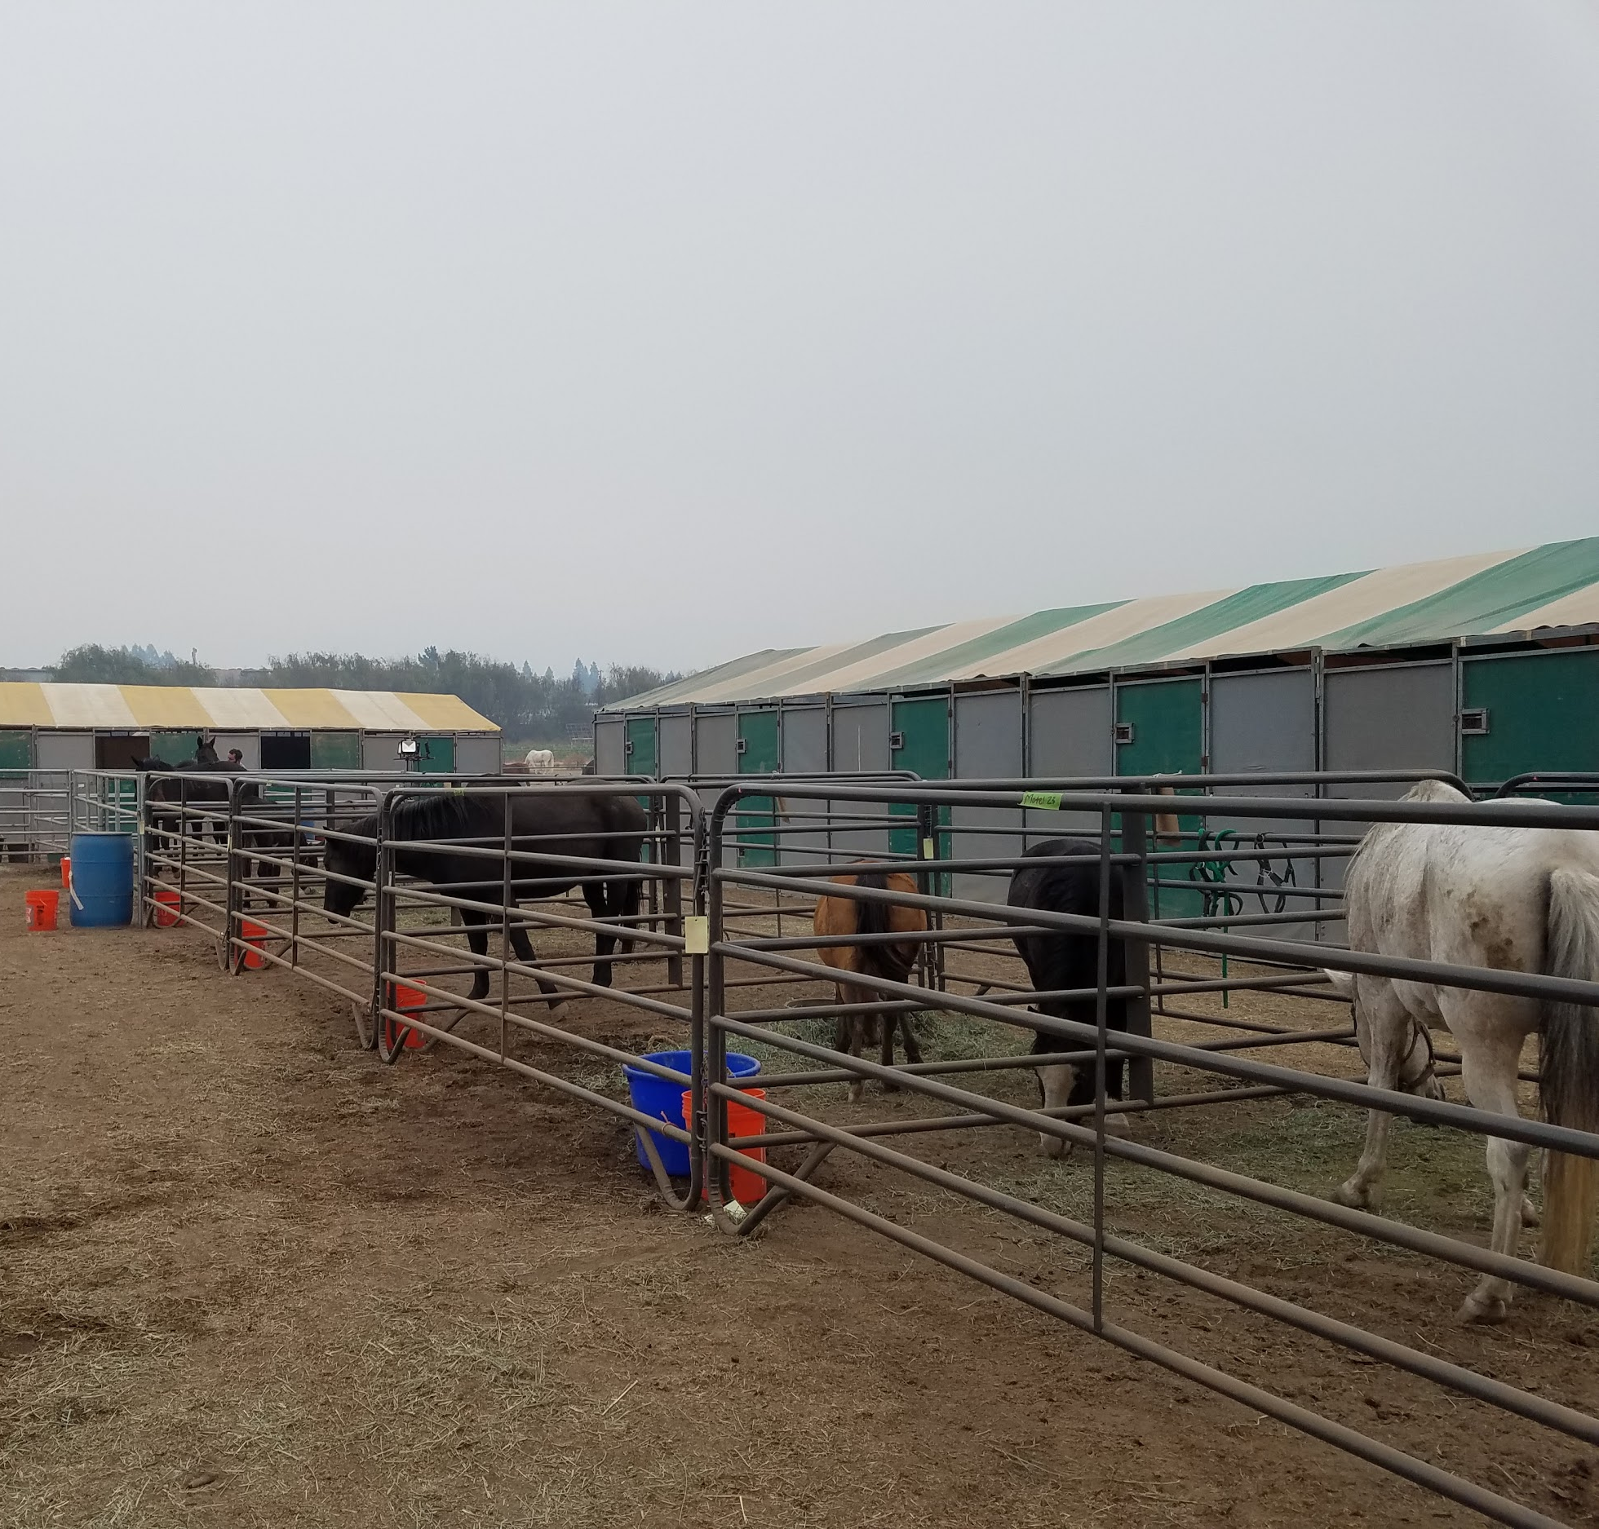
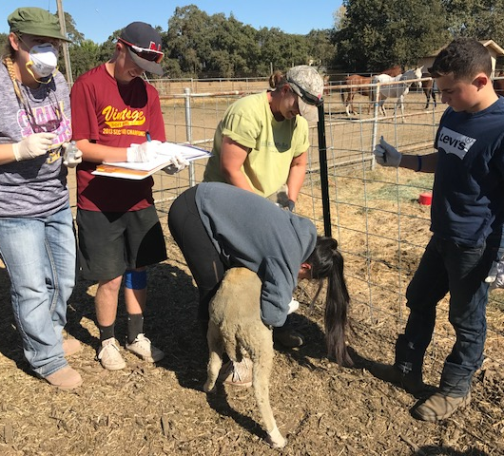
Livestock Sheltering
Administrative and physical roles
10+ years horse/LA experience and ability to take vitals
Proof of animal handling ability and interview with Team Leads
Current Tetanus and Rabies vaccination highly recommended
Livestock Sheltering - July 11, 2020
  Safe loading demonstration
Safe Animal Handling and Vitals - March 7, 2020
Notes:
Training Tracks - Megan

Slide 21
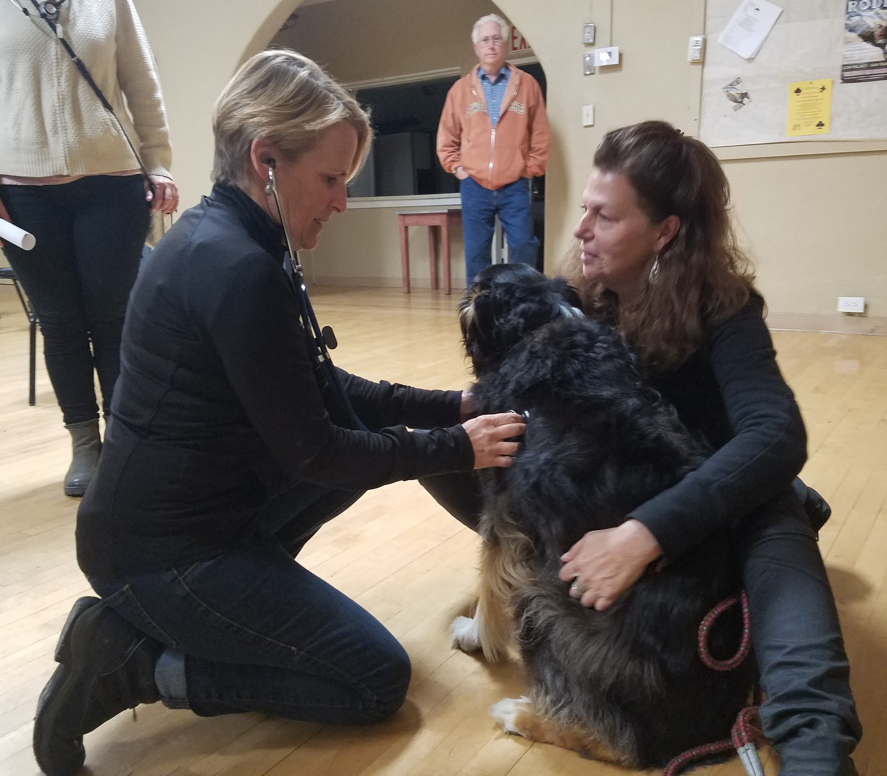
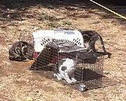
Small Animal Sheltering
Administrative and physical roles
Proof of animal handling ability and interview with Team Leads
Current Tetanus and Rabies vaccination highly recommended
Small Animal Sheltering - April 4, 2020
Safe Animal Handling and Vitals - March 7, 2020
Notes:
Training Tracks - Megan

Slide 22
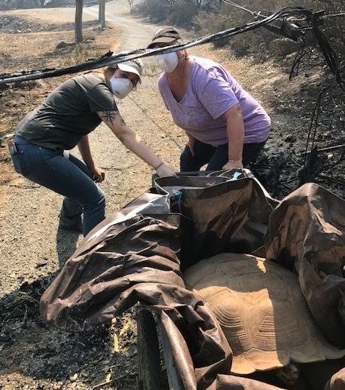
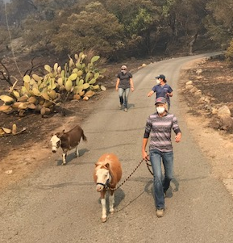
ASAR (Field Operations) Team
Administrative and Physical Roles
Proof of animal handling ability and interview with Team Leads
Ability to lift 50 lbs and pass fitness test
Current Tetanus and Rabies vaccination highly recommended
Fire Line Safety/All Hazards - Feb 2, 2020
Safe Animal Handling & Vitals - Mar 7, 2020
Field Operations Training - May 2, 2020
Communications Training- Aug 1, 2020
Drill - August 22, 2020
Notes:
Training Tracks - Megan

Slide 23
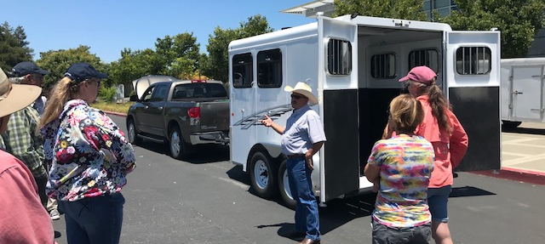
Animal Transport Technicians
Truck-Trailer Drivers
Clean DMV Record
License for trailer type
Proof of Insurance
Trailer Driving Course Certification - June 7,2020
Single Vehicle Drivers
(no trailer)
Clean DMV Record
Proof of Insurance
Notes:
Training Tracks - Megan

Slide 24
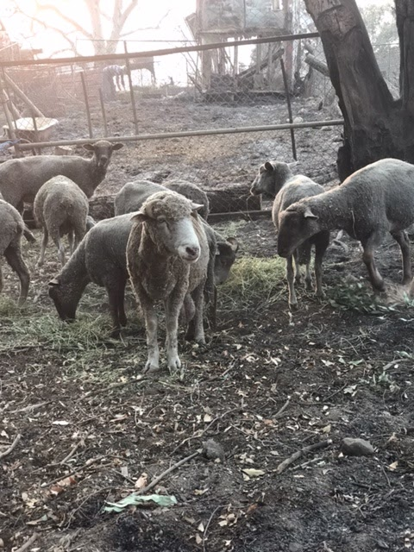
Animal Handling & Care Technicians
Safe Animal Handling & Vitals - March 7, 2020
Field Operations - May 2, 2020
Communications - Aug 1, 2020
Drill - August 22, 2020
Notes:
Training Tracks - Megan

Slide 25
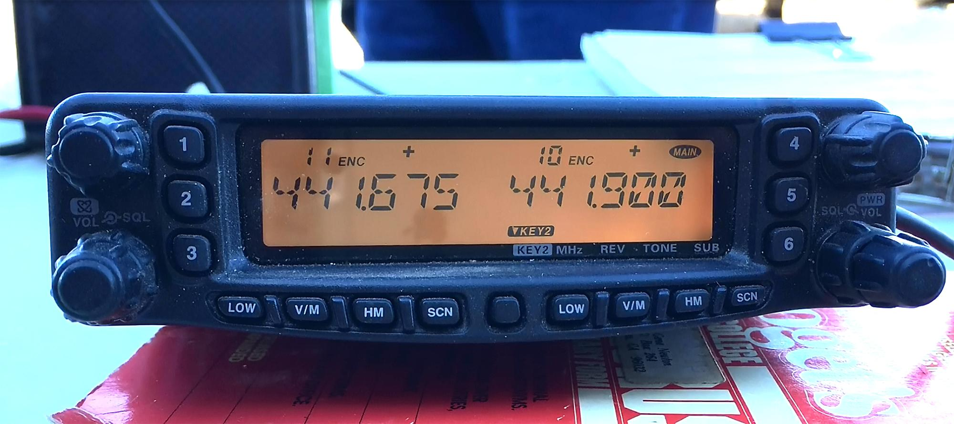
Animal SAR: Radio Operators
Dispatch/ Hotline Training - June 6, 2020
Communications Training - August 1, 2020 w CERT
Drill - August 22, 2020
Notes:
Training Tracks - Megan

Slide 26
Volunteer Protection Act of 1997
To provide certain protection to volunteers, non-profit organizations and governmental entities in lawsuits based on the action of volunteers.
Not liable if:
acting within the scope of their responsibilities
properly licensed, certified or authorized
harm was not caused by willful or criminal misconduct
harm not caused by operation of a motor vehicle
  Driver required to have their own insurance
Notes:
Volunteer Act - Megan

Slide 27
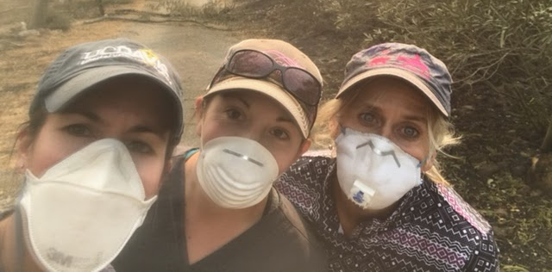
Napa Community Animal Response Team
Safety
and Overview of the Role of Safety Officer
Notes:
Safety - Jen

Slide 28

The Safety Algorithm
Personal Safety comes first
Team and others are next
Animals, even though they are why we are there, are last
Notes:
Safety - Jen
EXPLAIN WHY THIS “ORDER OF OPERATIONS” IS CRITICAL, AND HOW IT WORKS

Slide 29
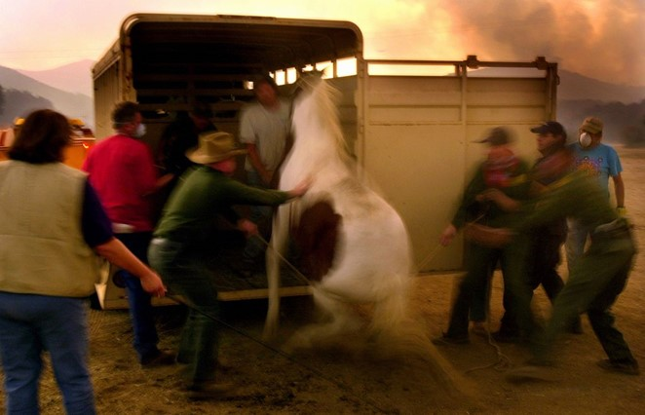
GETTING AN ANIMAL FROM RISK TO SAFETY:
WHAT COULD POSSIBLY GO WRONG?
Notes:
Safety - Jen

Slide 30


Use Your Imagination!
Animals are predictably unpredictable under stress
How can you decrease human and animal stress?
What hazards exist or could develop rapidly?
Can you remove or reduce any hazards?
What resources do we need?
Know when to STOP!
Notes:
INTRODUCE THE “SRPR” MODEL IN SIMPLE TERMS, USING EXAMPLES
INCLUDE HEAT STRESS/EXHAUSTION ETC, PROVIDING WATER/FOOD, WATCHING FOR PSYCHOLOGICAL STRESS OF TEAM MATES

Slide 31
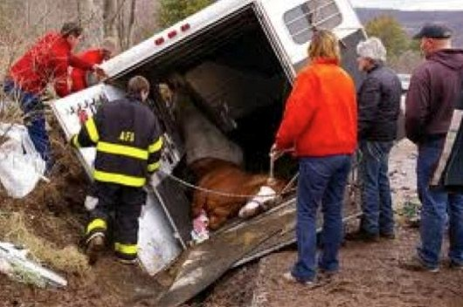
Situational Awareness
Notes:
Safety - Jen

Slide 32
Situational Awareness is the process of
assessing and constantly re-assessing risk
THE SCENE: Safe to enter now? Could conditions change? Is our “size up” broad enough? Can we reduce stress from noise/lights/movement? Alternative Exit/Escape Routes?
RISKS TO PEOPLE AND ANIMALS: Is a person or animal injured? Agitated? Unconfined? Debris or equipment in the way? Gas leaks? Flooding? Stallion? Aggressive dog? Keep evaluating body language!
THE PLAN: Will we make the situation worse by attempting to capture or move an animal? Do we have a Plan B, C, D…? What is our exit plan?
THE RESOURCES: Do we have the skills? The correct PPE? The right equipment? Should we wait for assistance from Veterinary, Animal Control, Fire Department?
Notes:
Safety - Jen
GIVE SELECTED EXAMPLES IN EACH CATEGORY

Slide 33
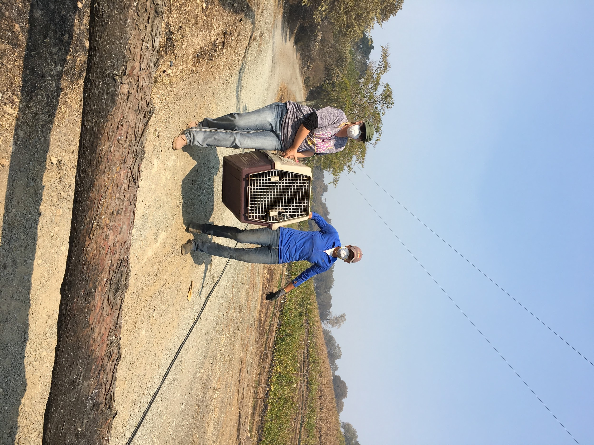
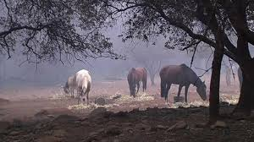
What is a “Safety Officer”?
Ideally, each team should have one member specifically designated as the safety officer during the operation.
This individual may have other functions, but they have the primary duty of maintaining situational awareness.
Notes:
Safety - Jen
DESCRIBE EXAMPLES BY TEAM, SUCH AS EVAC, SHELTER, SIP ETC.

Slide 34
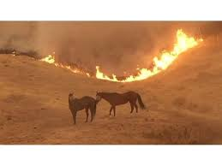
THERE MAY ALSO BE A SAFETY OFFICER ASSIGNED TO THE OVERALL OPERATION UNDER THE INCIDENT COMMAND SYSTEM
BUT SAFETY IS EVERYONE’S RESPONSIBILITY
Notes:
Safety - Jen

Slide 35
Sexual Harassment
If you see something, say something
Report any issues to your supervisor or team lead
Consider personal safety training
Remain vigilant when on scene - always have a partner
Napa CART will implement online training modules to improve awareness. Will accept work related training certificates.
Notes:
Sexual harassment - Claudia

Slide 36
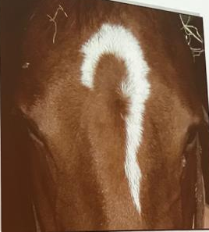

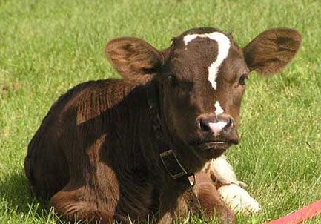
Questions?
Notes:
Questions - Claudia
10 minute break after this

Slide 37
Activation Timeline: When in doubt, check FB or Website
1
2
3
4
County activates Napa CART
Leadership & Advisory Board
Hauling Nixle
Volunteers Called in
and Assigned roles
Staging on RED Flag days
Leadership teams activate their core teams and make volunteer requests
Trailers and evac teams sent to designated rally point
Shelter teams set up
Report to leaders, create teams
Notes:
What happens when an incident unfolds - Claudia

Slide 38

3-Stage Notification County System
Alert/Stand By
Prepare/Spool Up/Get Ready
Deploy

Slide 39




Notification of Team Members
You will be notified through one or more of these:
County-generated Nixle or other App
Text from Napa CART
Phone call from Napa CART
Email from Napa CART (second to last resort)
Facebook Post from Napa CART (last resort)
Notes:
What happens when an incident unfolds - Claudia

Slide 40
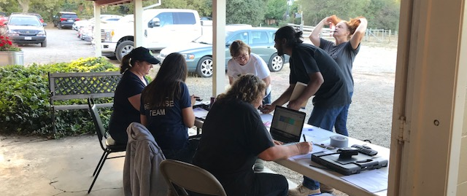
Napa Community Animal Response Team
Volunteer Coordination Overview
Notes:
Volunteer Coordination - Karen

Slide 41
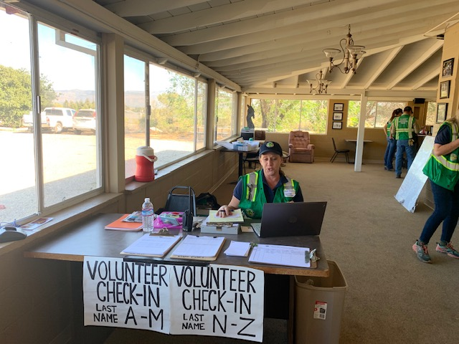
Volunteer Coordinator Responsibilities
Check in and support volunteers at trainings, deployments, & events
Coordinate short term/immediate volunteer staffing needs in deployment events
Coordinate long term volunteer staffing needs in deployment events
Maintain and support volunteer & training database
Collect and maintain training documents & volunteer files for volunteer & leadership

Slide 42
Training Logging
Volunteer Survey - complete survey through our website: napacart.org/volunteer-survey
Volunteer coordinator will track training - email certificates to volunteer@napacart.org
Those who have met the basic DSW criteria will receive a county issued Napa CART badge after clearing a background check
NVADG training is accepted by Napa CART
Future plans for training - standardized for mutual aid
Notes:
Volunteer Coordination - Karen

Slide 43
When A Disaster Has Been Declared
Preload with water and check go bag
Wear personal protective equipment (PPE) and start 214 form when you leave home to go to volunteer check in
Photograph odometer mileage/time on dash
Proceed to the designated Volunteer check-in location
Sign the check-in sheet and follow the instructions given by the check-in staff - Don’t forget to sign out when your shift is done! Times and dates to match 214 form
You may be asked to wait in a holding area while the staff checks your eligibility status, reviews what areas you are trained to serve in and looks for volunteer position staffing needs.
Notes:
Volunteer Coordination -Karen

Slide 44
When You Are Assigned To An Area
The check-in staff or site leader will provide you with any additional PPE or badging
The check-in staff will contact the Lead for that area for deployment instructions
Please stay in the area you are assigned - If you are needed in another area, you will be re-assigned by the volunteer check-in staff.
Please follow all given rules, protocols and posted command structure
If you have a concern or injury, check with your designated team/site leader.
Notes:
Volunteer Coordination - Karen

Slide 45
Immediate vs Long Term Needs
When an incident starts there is usually an immediate need for lots of help and an abundance of willing volunteers
After about week 3 of an incident, volunteer participation drops off, but the need may still be large
Plan to work a day or a few days in a row, then go home and rest, as hard as that may be
  Max 72 hours on, then 72 hours off
  Don’t burn yourself out
  Run the risk of endangering yourself and others
  We will likely need you again in a week or two
Notes:
Volunteer Coordination - Karen

Slide 46
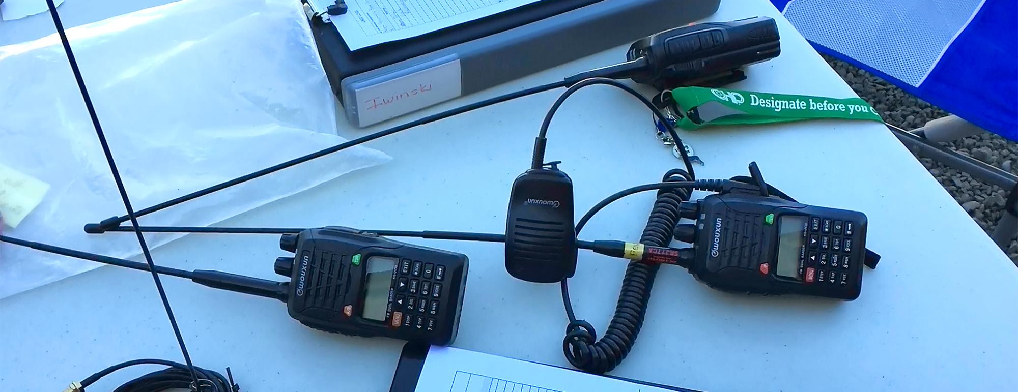
Napa Community Animal Response Team
Dispatch Overview
Notes:
Dispatch - Lisa

Slide 47
Dispatch Roles
Lead Dispatcher
Fills one of the roles below
Hotline Operator
Manages public requests for assistance
Radio Operator
Prioritizes requests and dispatches teams
Tracker
Tracks all movements of teams behind the lines
Notes:
Dispatch - Lisa

Slide 48
Dispatch Overview-Forms
Request for Animal Services (RFAS)- records individual requests for assistance from public
Hotline Register- Record of calls received by each hotline operator
Dispatch Log- Record of RFAS’s dispatched
214 (Unit Log)- To be filled out by every volunteer for each shift
Notes:
Dispatch - Lisa

Slide 49
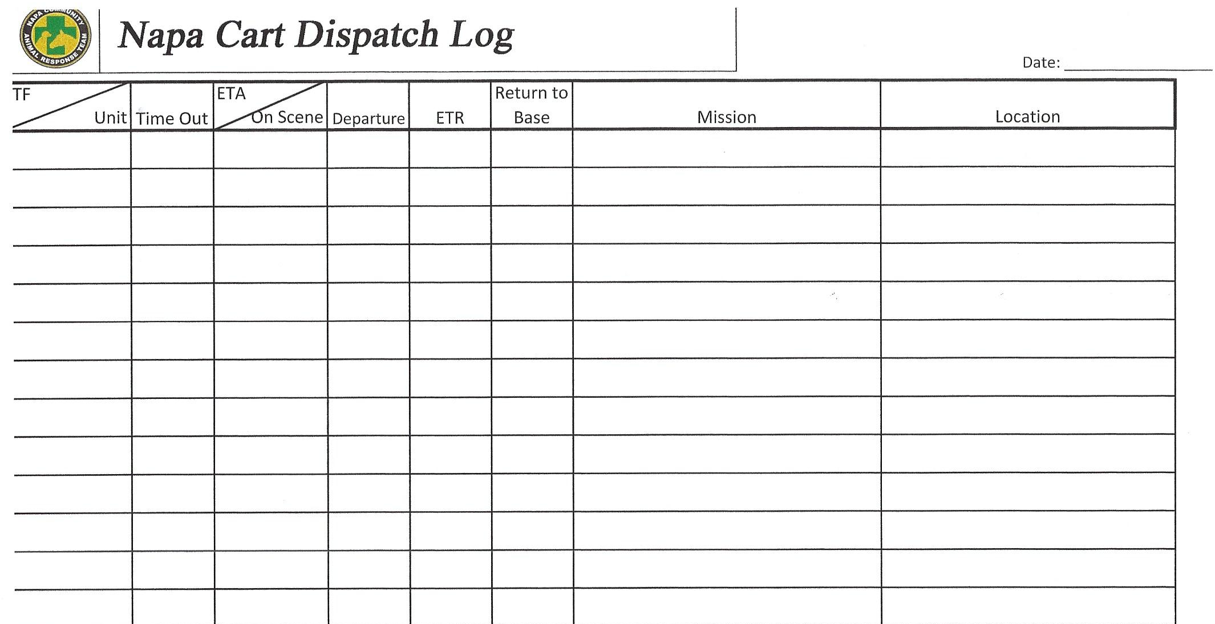
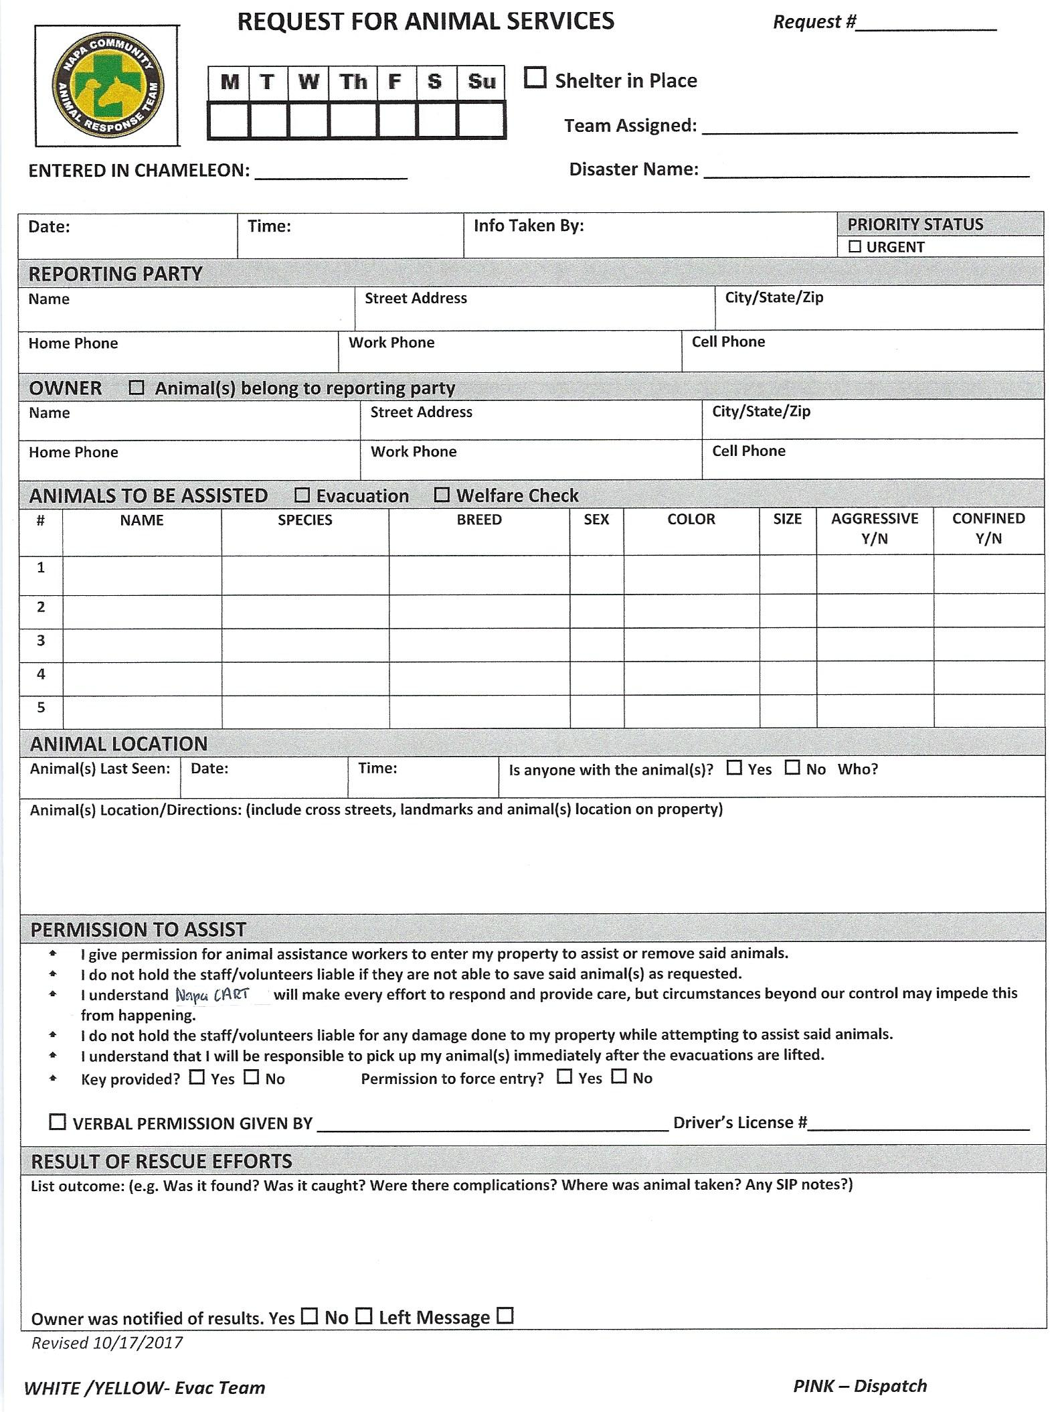
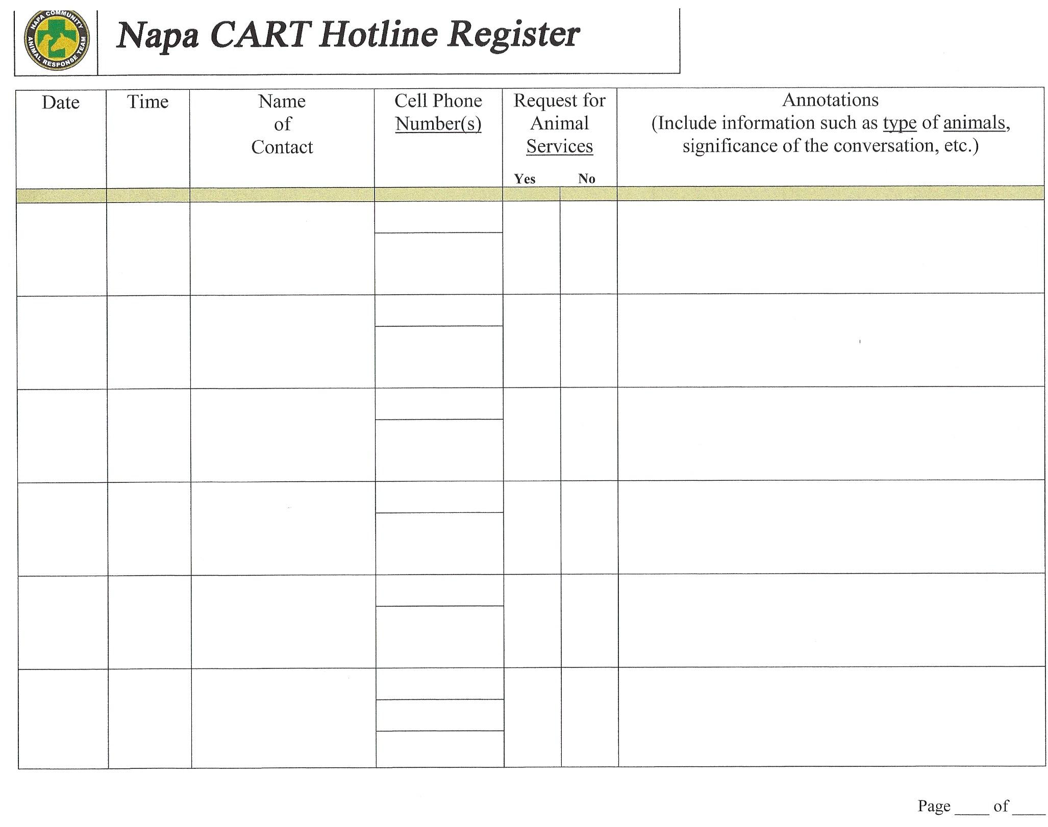
Examples of Dispatch Forms
Notes:
Dispatch - Lisa

Slide 50

Hotline Operator
Sign in/check-in with lead
Set up workstation
Add your phone to Ring Central OR familiarize yourself with Napa CART issued phone
Receive calls. Remember:
  Remain calm
  Be thorough
  Be kind
  Write neatly
End of shift: disconnect your phone OR return issued phone to charging station
Sign out/make sure your 214 is complete
Notes:
Dispatch - Lisa

Slide 51
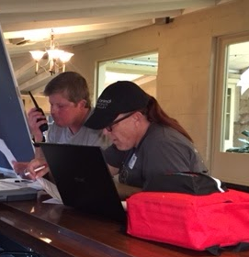
Dispatch Radio Operator
Sign in/check-in with lead
Set up workstation
Radio test with Evac teams
Work your shift:
  Prioritize RFAS requests
  Dispatch teams
  Tracking documents
End of shift: hand off station
(do not leave unattended!)
Sign out/make sure your 214 is complete
Notes:
Dispatch - Lisa

Slide 52
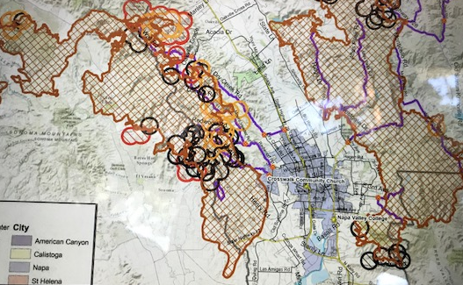
Dispatch Tracker
Sign in/check-in with lead
Set up workstation
Work your shift:
  Track all Evac team
activity- whiteboard
  Tracking with
technology
  Responsible for
knowing where teams are at all times
End of shift: hand off station (do not leave unattended!)
Sign out/make sure your 214 form is complete
Notes:
Dispatch - Lisa

Slide 53
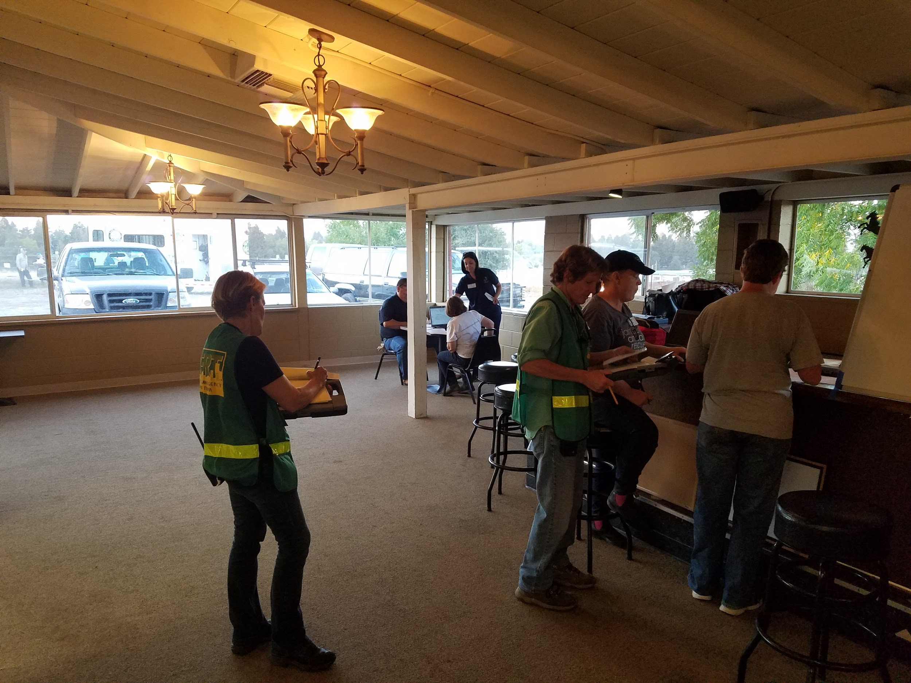
Dispatch - Training Opportunities
Dispatch training - June 6, 2020
Communications Training - August 1, 2020
Activation Drill - August 22, 2020
Notes:
Dispatch - Lisa

Slide 54

Napa Community Animal Response Team
Communications Overview
Notes:
Comms Claudia

Slide 55
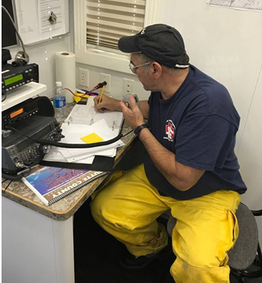
Communications Team
Radio Communications
Lifeline for the Evacuation Teams
Shelter radios - WT
Field radios - CB
Ham radios
Notes:
Comms

Slide 56

Radio Requirements
Need Frequencies for EACH division. Comm Team programs all mobile and handheld radios for the Evac Teams
Handheld CB- Line of sight/ power limit
Ham radios- specialized training, don’t require line of sight
All field teams need
designated radio
Air Ops is a perfect
frequency to monitor
Notes:
Comms

Slide 57


Slide 58
Conversational vs Clear Text
What did you say?
We are on our way to the animal evacuation
We need some additional help
Okay, I understand what you want me to do
“Hey you, it’s Me”
Repeat
Responding
Resource request
Copy
NCART Dispatch
NCART IC
Notes:
Comms

Slide 59

Comms - Training Opportunities
Dispatch training - June 6, 2020
Communications Training - August 1, 2020
Activation Drill - August 22, 2020
CERT training
Notes:
Dispatch - Lisa

Slide 60

Napa Community Animal Response Team
ASAR (Animal Search & Rescue) Overview
aka Field Operations
Notes:
Evac - Nancy & Mike

Slide 61


ASAR’s Team Mission
To ensure the best possible outcome for animals affected by a disaster
Notes:
Evac - Nancy & Mike

Slide 62


Animal Search and Rescue Teams
Work with First Responders and County Emergency Operations
Evacuate both large and small animals kept as pets, companion animals, or as part of agriculture
Provide Shelter in Place care for animals left behind
State law prohibits us from handling wildlife - 224-HAWK
Notes:
Evac - Nancy & Mike

Slide 63
ASAR Leads
Evac & Shelter-In-Place Leads:
Mike and Nancy Kerson, co-leaders
Transportation Lead:
Allen Harrison
Assistant Leads: steps in as leader if Incident occurs when regular leader is unavailable
Jen Borgen
Lisa Stewart
Vicki Dawson
Notes:
Evac - Nancy & Mike

Slide 64
When you get the Activation Notice
Respond ASAP:
(a) if you are coming,
(b) when you are coming, and
(c) what (if anything) you are driving
If you can’t go right away, respond with a brief email to info@napacart.org saying when or if you can be available.
Start your 214 form. Photograph odometer/time leave
Bring your Go-Bag and anything else you might want, such as folding chair, sleeping bag and pillow, change of clothes, food, any personal tools you may want, and WATER - important to stay hydrated!
Notes:
Evac - Nancy & Mike

Slide 65

What should you wear?
Sturdy, comfortable work shoes or boots
Long pants, preferably 100% cotton
Sun hat or Napa CART cap
Sunglasses
Your Napa CART shirt if you have one, or any 100% cotton shirt
Bring your CERT helmet, ID and vest
You may be issued special PPE’s (Personal Protective Equipment) at the staging area - Wear them!
Notes:
Evac - Nancy & Mike

Slide 66


ASAR Staging Area
Sign in
Wait in designated volunteer area until given an assignment
Each vehicle to be used for operations will be checked for safety and readiness
Notes:
Evac - Nancy & Mike

Slide 67
ASAR Teams Composition
ASAR Leads will assign Teams.
Will be determined by incident needs and volume of incoming requests from Dispatch
Minimum size: one vehicle with two people - No one goes alone!
Team vehicles may include:
  Pilot Car
  One or more Truck-Trailer rig(s)
  Supply & Water truck
Notes:
Evac - Nancy & Mike

Slide 68
Role Assignment
Every team, regardless of size, includes several roles that must be performed
Each role has specific responsibilities
Each role must be assigned to a specific person
People might be assigned multiple roles, but every role must have a person assigned to it
Make sure you understand your role(s) before heading out. Don’t be afraid to ask for clarification or review SOG
Notes:
Evac - Nancy & Mike

Slide 69
ASAR Team Roles
Team Leader
Safety Officer
Drivers
Co-Pilots
Scribe (log trip, fill out 214s)
Communications (radios)
Animal Handling & Care Technician (2 or more)
For most Incidents we are likely to use single truck-trailer teams of two people, so you are likely to have many roles.
Notes:
Evac - Nancy & Mike

Slide 70

Team Leader
Leads Team
Assigns roles
Plans operations
Criteria:
Good Judgement
Knows ICS (Incident Command System)
Good “People Skills”
Calm Under Pressure
Able to assess and respond to rapidly changing circumstances
Notes:
Evac - Nancy & Mike

Slide 71
Team Safety Officer
Looks after team well-being
  Reminds people to drink water, eat, take a break, etc. as needed
Monitors and assesses overall mission safety
Leads team size up upon arrival at site
Has the power to terminate the mission immediately, if in Safety Officer’s judgement, it has become too risky
Ideally, not distracted by other duties
Notes:
Evac - Nancy & Mike

Slide 72

Animal Transport Technicians
Appropriate license for trailer weight
DMV record on file
Vehicle must be in good working condition
Proof of registration
Proof of insurance
Notes:
Trans. Allen Harrison

Slide 73
Trailer Drivers
Same criteria as that of All Drivers
PLUS:
Trailer Safety & Maneuvering Course*
June 7, 2020 - inspection/driving test
Being Certified does not qualify you to self-deploy!
Notes:
Allen

Slide 74



Radio/Communications Operator
Monitors police and fire scanners
Communicates with Dispatch
Uses hand-held and Ham radios - plain speak
Logs and maintains equipment
Notes:
Evac - Nancy & Mike

Slide 75



Veterinarian or Vet Tech
Veterinary Team should be consulted before attempting any treatment in the field
Animal Care & Handling Specialist(s) on each team will work with Veterinary Team as necessary to assess health and provide emergency care until animal can be brought in
Notes:
Evac - Nancy & Mike

Slide 76

Animal Care & Handling Specialists
Catch, handle and load the animals for Evac
Care for animals in SIP
Perform Search and Rescue in warm zones after a disaster
Must be familiar with a variety of species
Must be in good physical condition
Notes:
Evac - Nancy & Mike
This is less of an issue for “ordinary” evac but for post-disaster “warm zone” work, which may involve long walks through difficult terrain, the person needs to be in good physical condition.

Slide 77


Equipment Sign-Out
Each team will be issued relevant equipment, including radio, animal handling tools, maps, and water supply for both humans and animals
Equipment must be officially signed out with time and signature
Upon return, sign it back in
Notes:
Evac - Nancy & Mike

Slide 78


Before Heading Out
Test radios and walkie-talkies; Call to Dispatch. Say “NCART (X) Radio Check.”
Quick Team Meeting:
  Plan A & Plan B
  Review contingencies
  Decide on a rally point if separated, whistles
Make sure each vehicle has full tank
Check each vehicle’s drinking water supply
Make sure you have your forms
Notes:
Evac - Nancy & Mike

Slide 79

Arriving at your Destination
Park your vehicle facing out toward your exit route
Conduct SRPR with Safety officer - make plan
Groups of two will go get the animals - no one goes alone!
Notes:
Evac - Nancy & Mike

Slide 80
Request For Animal Services (RFAS)
Calls to Hotline generate RFAS
Dispatch assigns RFAS to an ASAR Team
You may be asked to evacuate animals, to provide Shelter In Place, or simply to do a welfare check on them.
You may also be assigned to a Search (Scout) team to look for survivors in a warm zone after the fire (or flood or whatever) has passed through.

Slide 81





Exotics
Exotic Animals = Animals kept as pet or business, other than dogs, cats, horses, and livestock.
Examples: Birds, reptiles, rabbits, hamsters, guinea pigs, waterfowl, pheasants, ferrets, amphibians, fish, tarantulas, llamas, alpacas, zebras and zebra hybrids, camels, bison, ostriches, emus.
Exotics have specific care and handling requirements that we may not be familiar with. Some exotics are dangerous.
If you are unsure, call for assistance. We will find an expert.

Slide 82
Paperwork
Leave “door hanger” or other document to inform owner where the animal(s) have been taken and how to contact Napa CART
For SIP, put up signage and caution tape to inform passers-by that animals are being cared for. Include Napa CART phone numbers
Mark or attach an identification number to each animal
A log must be kept of all actions performed, as well as any new orders from Dispatch
Inform Dispatch of continuing care needs for each animal in SIP
Notes:
Evac - Nancy & Mike

Slide 83


Post if Animals are Evacuated
Notes:
Evac - Nancy & Mike

Slide 84

Post for
Shelter In Place
Note any behavioral/safety issues
Hang care notice
Report back to Dispatch, plan for continued care
Call owner with update/questions and log conversation onto animal care sheet
Notes:
SIP - Claudia

Slide 85


Animal Numbering & Paper Trail
Each animal will be assigned an ID number, which will be marked or attached to the animal (by neck tag, livestock crayon, etc)
Use RFAS number
That ID number will be used on all records pertaining to that animal, from pick-up to return to owner
Notes:
Evac - Nancy & Mike

Slide 86
Returning to Shelter
Unload the animals where shelter personnel direct you
Make sure Shelter receives RFAS and any relevant notes with animal ID and information on it
Make sure Dispatch gets copy of Animal Care Sheet or other continuing care needs
All rigs must be thoroughly disinfected as described in Napa CART Biosecurity Guidelines
Inventory and replenish supplies and equipment
Any equipment that was checked out must be checked back in
Notes:
Evac - Nancy & Mike

Slide 87

At the end of each day
Debrief with others and hand-off relevant info to next crew
Fill out, sign, photograph your 214 Form; Turn in if you are not coming back the next day.
Shower and change clothes before touching own animals
Notes:
Evac - Nancy & Mike

Slide 88

When Incident is over
Follow check-out procedures and make definitive animal identification prior to loading animals for home
Transport animals back to owner, if owner cannot provide transportation
Clean, disinfect equipment, put away, and restock supplies
Notes:
Evac - Nancy & Mike

Slide 89

Field Operations Training
ASAR Training - May 2, 2020
Hauling Certification Training - June 7, 2020
Activation Drill - August 22, 2020
Notes:
Evac - Nancy & Mike
Evac/SIP Step-by-step walk-through, catch-lead-load practice, and safety with evac/SIP tools and equipment - Dates TBA

Slide 90

Completed 214
Form
Notes:
Evac - Nancy & Mike

Slide 91

Napa Community Animal Response Team
Shelter in Place (SIP) Overview
Notes:
SIP - Claudia

Slide 92



Shelter In Place
After disaster has occured, animals will be left behind
If safe and infrastructure is present, leave on site?
Discuss with team leader, dispatch, vet, owner
Familiarize self with species
If an animal or situation seems unsafe, do not approach - call Animal Control
Notes:
SIP - Claudia

Slide 93


You encounter an animal, now what?
Various species
Triage - injuries, depression?
Water, fencing, shelter?
Assign numbers SIP…
Leave food, water - default grass hay
Leave Shelter In Place Notice
Notes:
SIP - Claudia

Slide 94

Code of Conduct
If entering a home, follow instructions given by Dispatch
Take a partner with you and stay together
Do not let confined animals out
Toilet seat up
Feed animal’s own food if possible
Leave it as you found it, note any sign of forced entry
Background checks
Notes:
SIP - Claudia

Slide 95



Everything melts…
Except wire, nails...
Notes:
SIP - Claudia

Slide 96

Supply Truck’s Role
Primarily used for Shelter-In-Place but may be used for Evac
Carries water, bales of hay, & bags of feed for various common species, tools, temporary fencing, etc.
Notes:
SIP - Claudia

Slide 97

Animal Care Sheet for SIP
This form not only records the care given, it also shows incoming crews what they need to do.
Good records are essential to maintaining continuity of care for each SIP animal.
Send a photo of this form to dispatch and to your field lead.

Slide 98



SIP Training Opportunities
Safe Animal Handling & Vitals - Mar 7, 2020
SA Shelter - April 4, 2020
ASAR - May 2, 2020
LA Shelter - July 11, 2020
Activation Drill - August 22, 2020
Notes:
SIP - Claudia

Slide 99

Napa Community Animal Response Team
Companion Animal Shelter Overview
Deassa Binstock, Napa Humane
Notes:
SA Shelter - Scott

Slide 100


Companion Animal Shelter
Safekeeping of displaced animals during an emergency
Arrange medical care of the animals when necessary
Maintain a safe shelter environment-co location
Reunification of the animals to their proper owners
Notes:
SA Shelter -

Slide 101


Response
Once Activated:
Grab your Go Bag and start your ICS 214 form
Respond to location listed on Activation notice
Upon arrival, check in with Shelter Lead
Prepare yourself to do whatever job you are assigned to
Take breaks when needed and hydrate
Rest and repeat
Notes:
SA Shelter -

Slide 102
What To Expect
Napa County Animal Shelter oversees and directs the companion animal response
Once activated, our goal is to be enroute to the designated shelter with the companion animal response trailer within the hour
Once we arrive at the site, be able to start accepting animals within the hour. This involves:
  Setting up intake desk
  Assembling and arranging crates in dog and cat areas
  Creating shelter map and filling roles
Notes:
SA Shelter - Wendi

Slide 103
Companion Shelter Positions
Companion Animal Shelter Lead-Veterinary Liaison
Assistant Companion Animal Shelter Lead
Dog Lead
Cat Lead
Safety Officer-Security
Sanitation specialist/Exercise Specialist
Intake and reunification specialist
Veterinary Team
Notes:
SA Shelter - Wendi

Slide 104

Typical Work Day May Include
Feeding
Watering
Dog walking
Cage cleaning
Donation management
Intake documentation
Monitoring
Trash collection
Notes:
SA Shelter - Wendi

Slide 105

Companion Animal Trailer
Notes:
SA Shelter - Wendi

Slide 106


Companion Animal Trailer
Notes:
SA Shelter - Wendi

Slide 107


Companion Animal Trailer
80 cages Equipment Supplies
Signage Forms Roles
Desk White boards
Notes:
SA Shelter - Wendi

Slide 108
Master Intake/Animal Care Sheet

Slide 109
Intake & Reunification
Many times the first contact we have with an evacuee will be our Intake Team-Crucial role
Emotions can be through the roof. This person may have just lost their home
Be the calming influence while documenting the intake of animals, situational awareness
Accuracy in documentation is critical
Follow protocols- wrist bands with matching animal id numbers. Forms completely filled out.
Notes:
SA Shelter - Wendi

Slide 110

Sanitation/Biosecurity
Starts with Intake and continues on throughout the incident through following procedures for cage cleaning, vet evaluation, disinfecting all areas of the shelter
Document and report
signs of infectious dz
(V,D,C,S)
Designate Isolation area
Pick up after animals
Manage Stress
Consult w Veterinary Team at intake
Notes:
SA Shelter - Wendi

Slide 111

Shelter Lead
Create & update Site Map- ideally ahead of time
Cat area/ Dog area/ Isolation within each
Oversee set up-drill if possible
Display signage/white boards with ICS
Report numbers to leader
Handle site logistics
  Volunteer needs
  Food
Notes:
SA Shelter - Wendi

Slide 112




Shelter Volunteers Should Carry
Large slip lead
Small slip lead
Whistle
Diagonal pliers
Poop bags
Ballpoint pen
Sharpie marker
Extra zip ties
Pocket notepad
Notes:
SA Shelter - Wendi

Slide 113

Is Anyone Still Awake?
Notes:
SA Shelter - Wendi

Slide 114

Companion Animal Shelter - Upcoming Training Opportunities
Animal Handling and Vitals - March 7,2020
Small Animal Shelter Training - April 4, 2020
Activation Drill - August 22, 2020
Notes:
SA Shelter - Scott

Slide 115

Napa Community Animal Response Team
Livestock Shelter Overview
Notes:
LA Shelter - Sheila

Slide 116

Livestock Shelter Mission
To shelter and care for Livestock during a declared evacuation
Notes:
LA Shelter - Sheila

Slide 117


Livestock Shelter
The livestock shelter team is responsible for coordination and management of Livestock sheltering needs at our designated sheltering sites
Notes:
LA Shelter - Sheila

Slide 118
Livestock Shelter Sites
Currently there are 2 Livestock Shelter sites:
  Napa Valley Horsemen’s Association
    Foster Road, Napa
  Valley Brook Equestrian Center
    El Centro Ave, Napa
  Up Valley location pending fairground sale
  Ruminant Site in progress - Napa Valley Expo a possibility
Notes:
LA Shelter - Sheila

Slide 119
Livestock Shelter Lead Roles
Currently there are 3 main livestock shelter leadership roles:
  Livestock Shelter Lead
    Sheila Edginton
  Assistant Shelter Leads
    Heather Edginton
    Available
  Site leads
    Valleybrook Site - Available (x2)
    Napa Valley Horsemen’s - Available (x2)
    Napa Valley Expo- (x2)
Notes:
LA Shelter - Sheila

Slide 120
Livestock Shelter Lead
Oversees all Shelter Sites
Coordinates with Dispatch on availability of shelter and where to direct evac teams dropping off animals
Reports nightly statistics
Liaise Veterinarians and RVT’s
Maintains Livestock Shelter Equipment Trailer
Notes:
LA Shelter - Sheila

Slide 121


Assistant Shelter Leads
Provide assistance to Shelter Lead:
  Coordinates with Site Leads for needs of volunteers and supplies at each shelter site
  Work with the Volunteer Lead to supply volunteers when and where needed
  Coordinates security guards
  Works with Safety officer
  Supports Lead
Notes:
LA Shelter - Sheila

Slide 122


Shelter Site Leads
Manage Shelter Sites:
  There is one appointed Shelter Site Lead for each location
    When only one site is open, then all leads will rotate duties at that site
  Coordinate all Team Members at appointed site
  Reports to Assistant Leads all needed supplies and statistics daily
  Set up feed and cleaning
schedules
Notes:
LA Shelter - Sheila

Slide 123
Team Members
May fill more than one of these roles:
Intake Specialists - Intake (2) , Volunteer Coordinator (1), Procurement (1), Communication (1), Intake Runner (2), Human Needs (1) = Total of 8
Feed Specialists - Care Team (1 per 10 horses), Safety Officer (1) = Depends on # of horses (5 to start)
  Isolation - Vet Assistant (1), RVT (1), Care Team (2)
Sanitation Specialists - Safety Officer (1), Traffic Monitors (3), Security (1), Bio-Security (3), Grounds (2) = Total of 10
Grand Total of 27
Notes:
LA Shelter - Sheila

Slide 124



Nutrition and Biosecurity
To reduce gut irritation from new feed:
  Partial feed initially, own hay if possible, wean up. Default to grass hay if diet unknown.
Biosecurity requires organization and diligence
  Reduce Exposure: Horse to Horse; Human to Horse
  Disinfection of Shoes, Stalls and Equipment
  Isolation Unit
Notes:
LA Shelter - Sheila

Slide 125

Interested in working with the Livestock Sheltering Team?
Notes:
LA Shelter - Sheila

Slide 126

Livestock Shelter - Upcoming Training
Safe Handling and Vitals - March 7,2020
Livestock Shelter Training - July 11, 2020
Activation Drill - August 22, 2020
Notes:
LA Shelter - Sheila

Slide 127


Questions?

