Slide 1
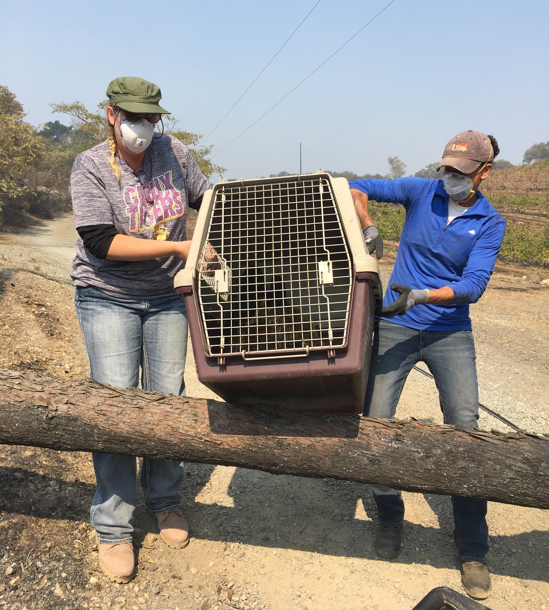
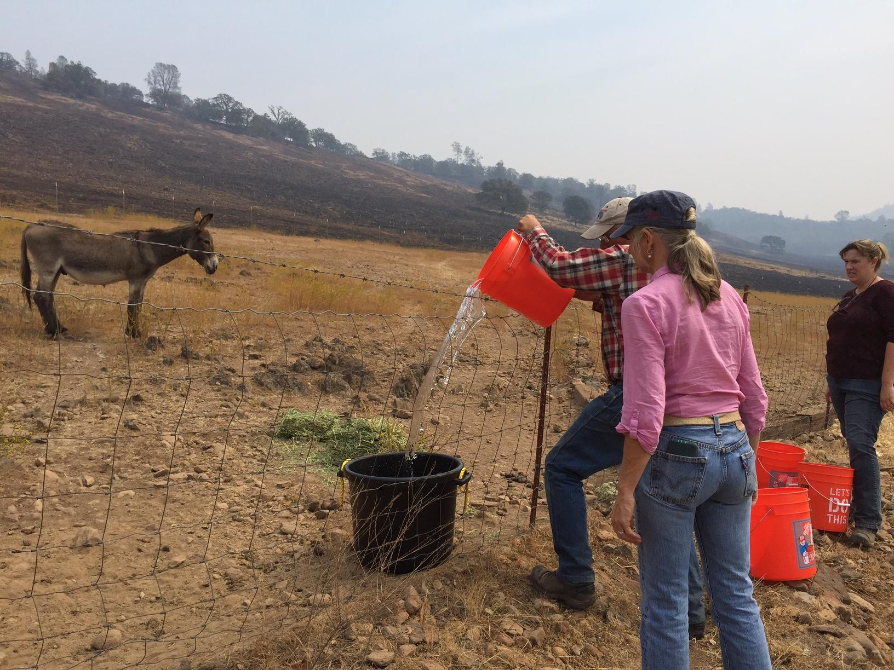
Napa Community Animal Response Team
Animal Search & Rescue (Field Operations)
HOME STUDY LESSONS 6 & 7
Shelter In Place (SIP)
Small Animal Handling
End of Day & End of Incident Procedures
Scenarios
Notes:
1 hour 5 minutes (including watching the videos)
1

Slide 2
Topics
Small Animal Evacuation
Reading Dog & Cat Behavior
Chickens & Related Poultry
Shelter In Place Procedures
Evac: The Lily Pad Option
Forms Used for SIP, Evac
Deceased Animals
Field Safety Issues
Mission Wrap-Up
Shift Hand-Off
Debriefing
Sign Out

Slide 3
Videos Used In This Unit
This unit includes several videos. If you prefer to watch them all at once, here they are:
Dog Safety: http://www.youtube.com/watch?v=mJOth6Qk92o
Dog Body Language http://www.youtube.com/watch?v=2dshMP9g1aM
Safe Muzzles http://www.youtube.com/watch?v=s_5-o24qZo8
Cat Handling Safety http://www.youtube.com/watch?v=UIyfNM6y3vU
Rabbit Handling Safety http://www.youtube.com/watch?v=KD9jQtzLBbc

Slide 4
Catching & Loading Animals (any species, large or small)
Large animal or small, you have these choices:
Halter or leash animal and lead it into a cage or trailer
Lure the animal(s) into the cage or trailer
Build a catchment chute and herd/drive the animal(s) into the cage or trailer
Catch and carry the animal to the cage or trailer
How to Choose:
Observe the animal’s behavior
Be honest about your own abilities
Choose the method most likely to succeed

Slide 5
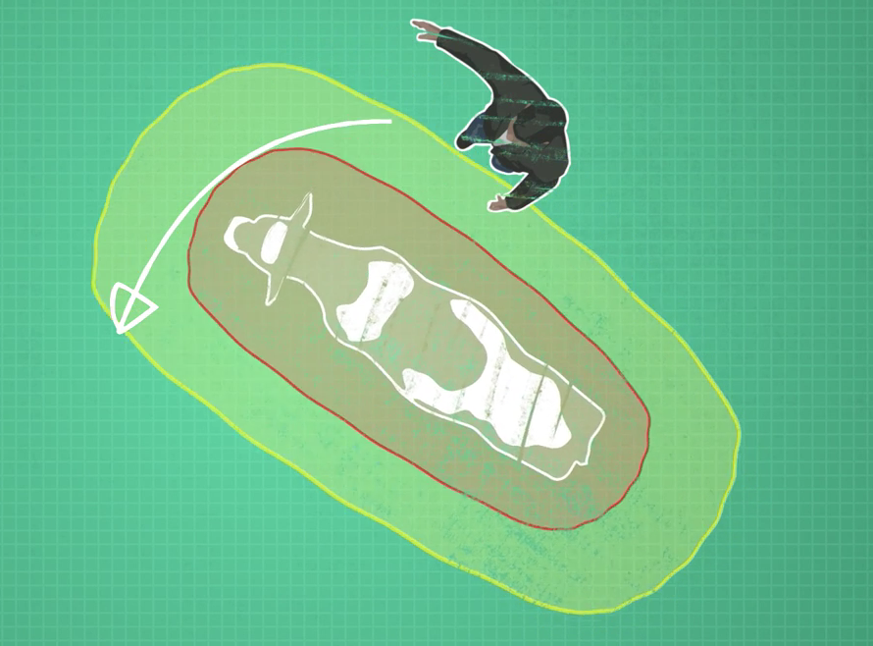
The Flight and Pressure Zones
All animals (including humans to some extent) have two invisible but highly palpable fields around themselves:
The Flight Zone (red): If you enter another animal’s flight zone, they become extremely uncomfortable and will flee if possible, or fight if prevented from fleeing. (In humans we call this having our Personal Space invaded)
The Pressure Zone (yellow/green): This is the zone you will work with when moving an animal that you can’t halter or leash. A person directing the animal from the Pressure Zone can encourage with minimal stress to the animal.

Slide 6
Flight & Pressure Zone, continued
Variables that influence the Flight and Pressure Zones:
Your emotional state and energy; If you are calm and confident, you can get closer.
Environmental factors such as: unusual lights, sounds, and movement in the area (You may want to politely ask people to turn off sirens and flashing lights for just a few moments to give you a chance to catch an animal; wait til the helicopter passes over or noisy vehicle passes, etc.)
The animal’s own temperament, past experiences and training
For a quick and successful evacuation, recognize and work with these factors. Try to minimize stress to the animal.

Slide 7
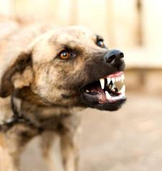
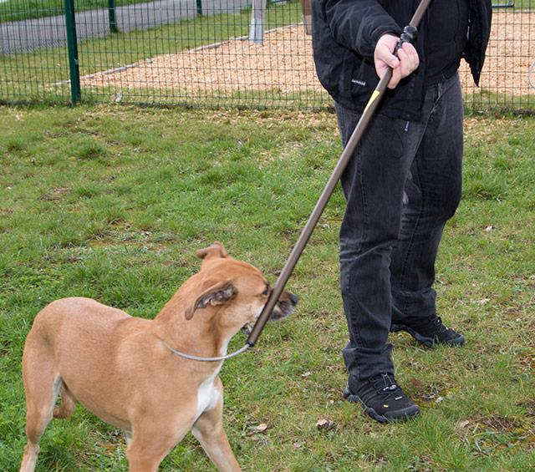
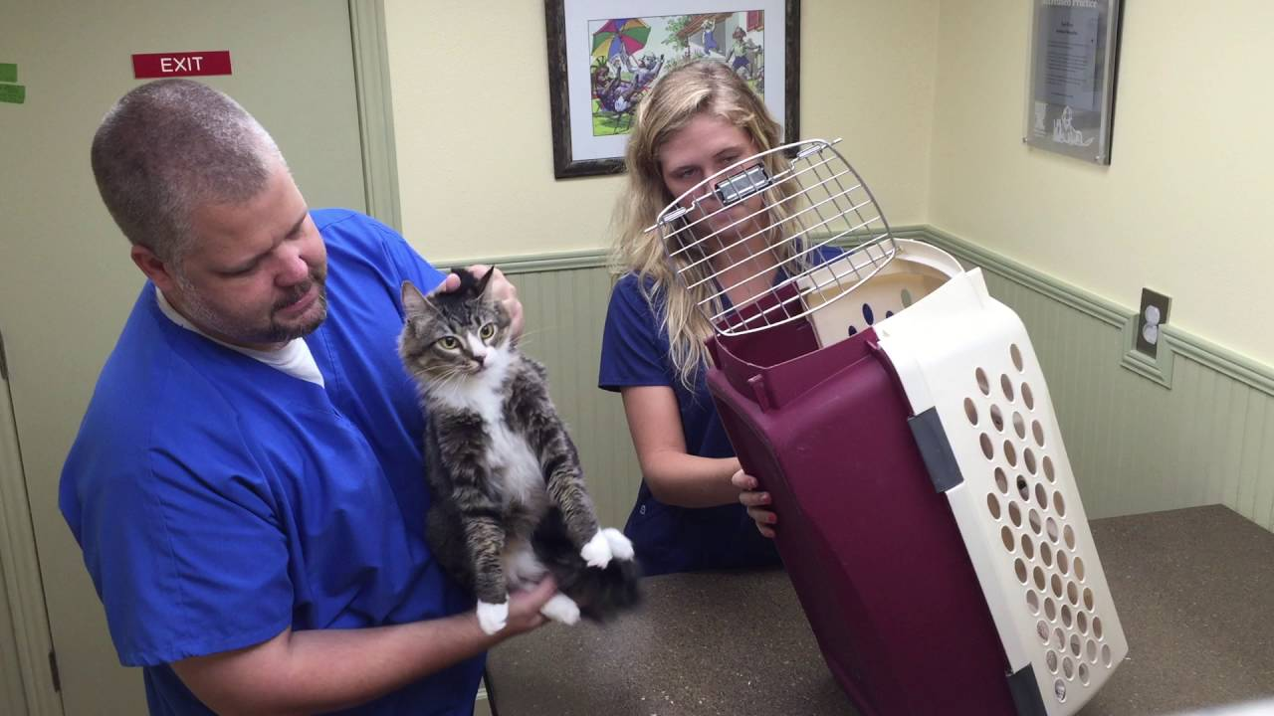
Evacuating Small Animals
Use crates for Dogs, Cats, Rabbits, Chickens, etc. (a friendly, well-behaved,leashed and trustworthy dog may be allowed to ride in the car with volunteers. In such case, keep windows up!)
If animal is unsafe to approach and catch, don’t! Call Animal Control.
Don’t attempt to lead or pull a snared animal.
Stand still and have a buddy bring the cage to the animal.
Safe cat handling:
Hold with one hand supporting hind end and the other holding the loose skin on the back of the neck
If an animal seems unsafe to approach, Don’t!
Ask for help!

Slide 8
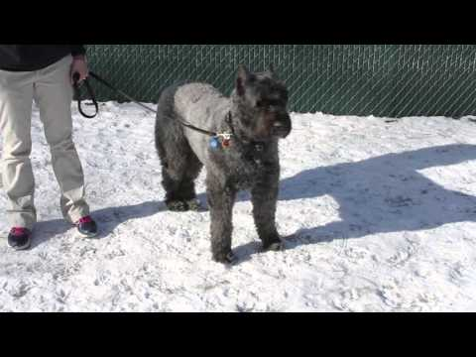
Safely Approaching Dogs
Click on image to see video
Notes:
5 minutes 38 seconds

Slide 9
Dog Behavior
The Tail tells the Tale:
Wag to the Right = Happy
Wag to the Left = Beware

Slide 10
Dog Body Language
Click on image to see video
Notes:
3 minutes 50 seconds

Slide 11
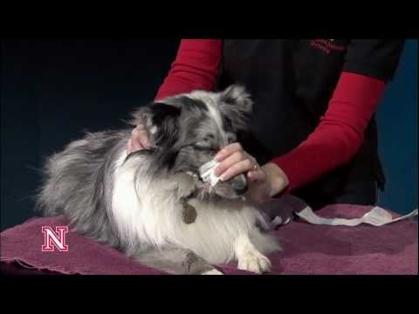
Muzzle a dog who might bite
We have a very limited supply of ready-made dog muzzles. Here’s how to make one in a pinch:
Click on image to see video
Notes:
Just under 3 minutes

Slide 12
Cat Body Language

Slide 13
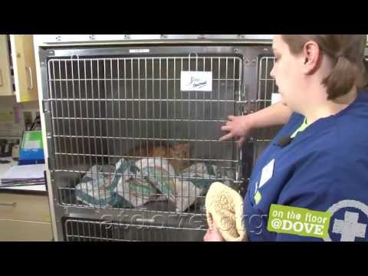
How to Handle an Angry Cat
Click on image to see video
Notes:
10 minutes 14 seconds

Slide 14
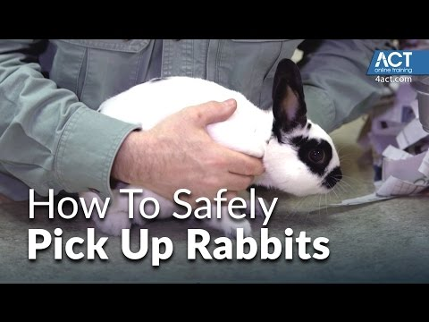
Rabbits
Be extra careful handling rabbits, as their fragile spines can be seriously, or even fatally, damaged if they struggle when held.
Click on image to see video
Notes:
5 minutes 22 seconds

Slide 15
Chickens: Unique Challenges
Facts:
Poultry are sensitive to air quality
Poultry are prone to respiratory illnesses
Poultry confined to a pen during a wildfire have a low-to-zero survival rate
A loose chicken can be eaten by a predator
Because of the threat of Newcastle Disease, NapaCART is unable to accept poultry into our shelters.

Slide 16
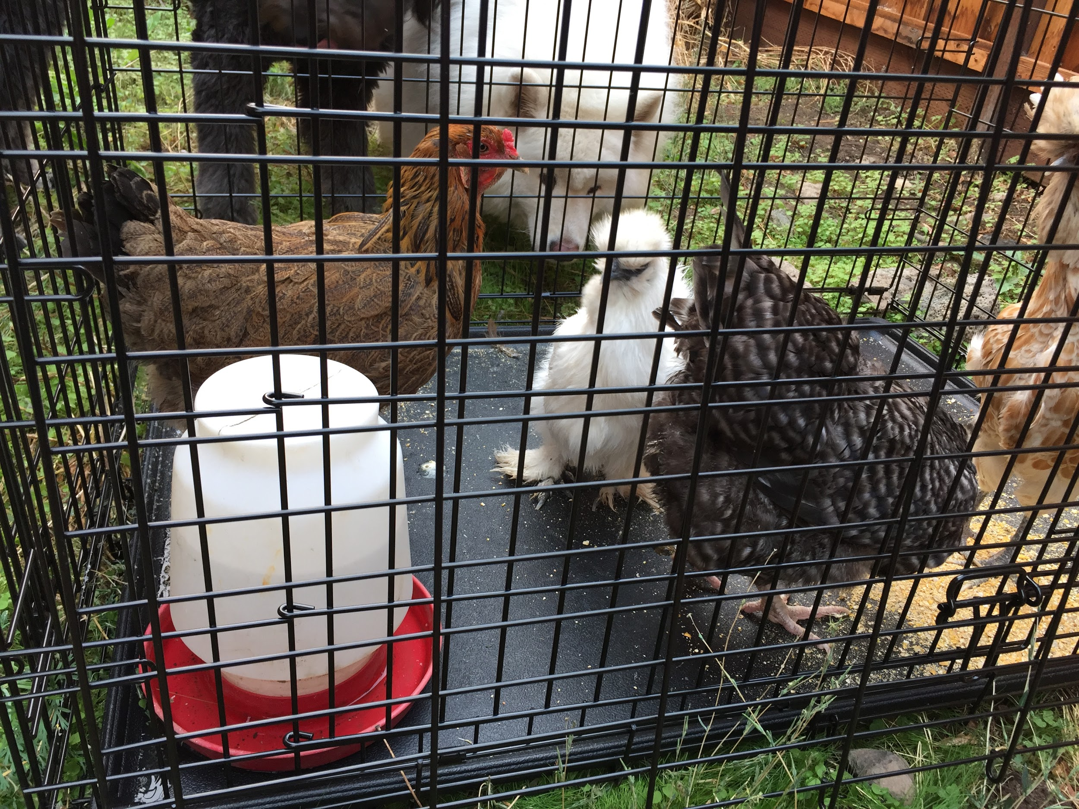
What CAN you do for Poultry?
Left: Surviving loose chickens in flock with about a 50% survival rate after 2015 Valley Fire.
Right: Chickens being sheltered in urban backyard during Wine Country Complex Fires.
Poultry is best sheltered in place if at all realistic.
If evacuation seems to be the only option for the birds’ survival, the owner may arrange a place (such as with friends or family) for you to take them.
Protect birds from drafts during transport.
If evacuation is not possible and the threat of wildfire is very high, release the poultry from their pen and hope for the best. Provide water and food.
After the fire, come back and care for survivors
Notes:
Note: In the case of Kerson Family chickens, they need to be evacuated. We have enough crates, and want them evacuated to our daughter’s house in town. Too many predators and the pen is surrounded by shade trees that can burn.

Slide 17
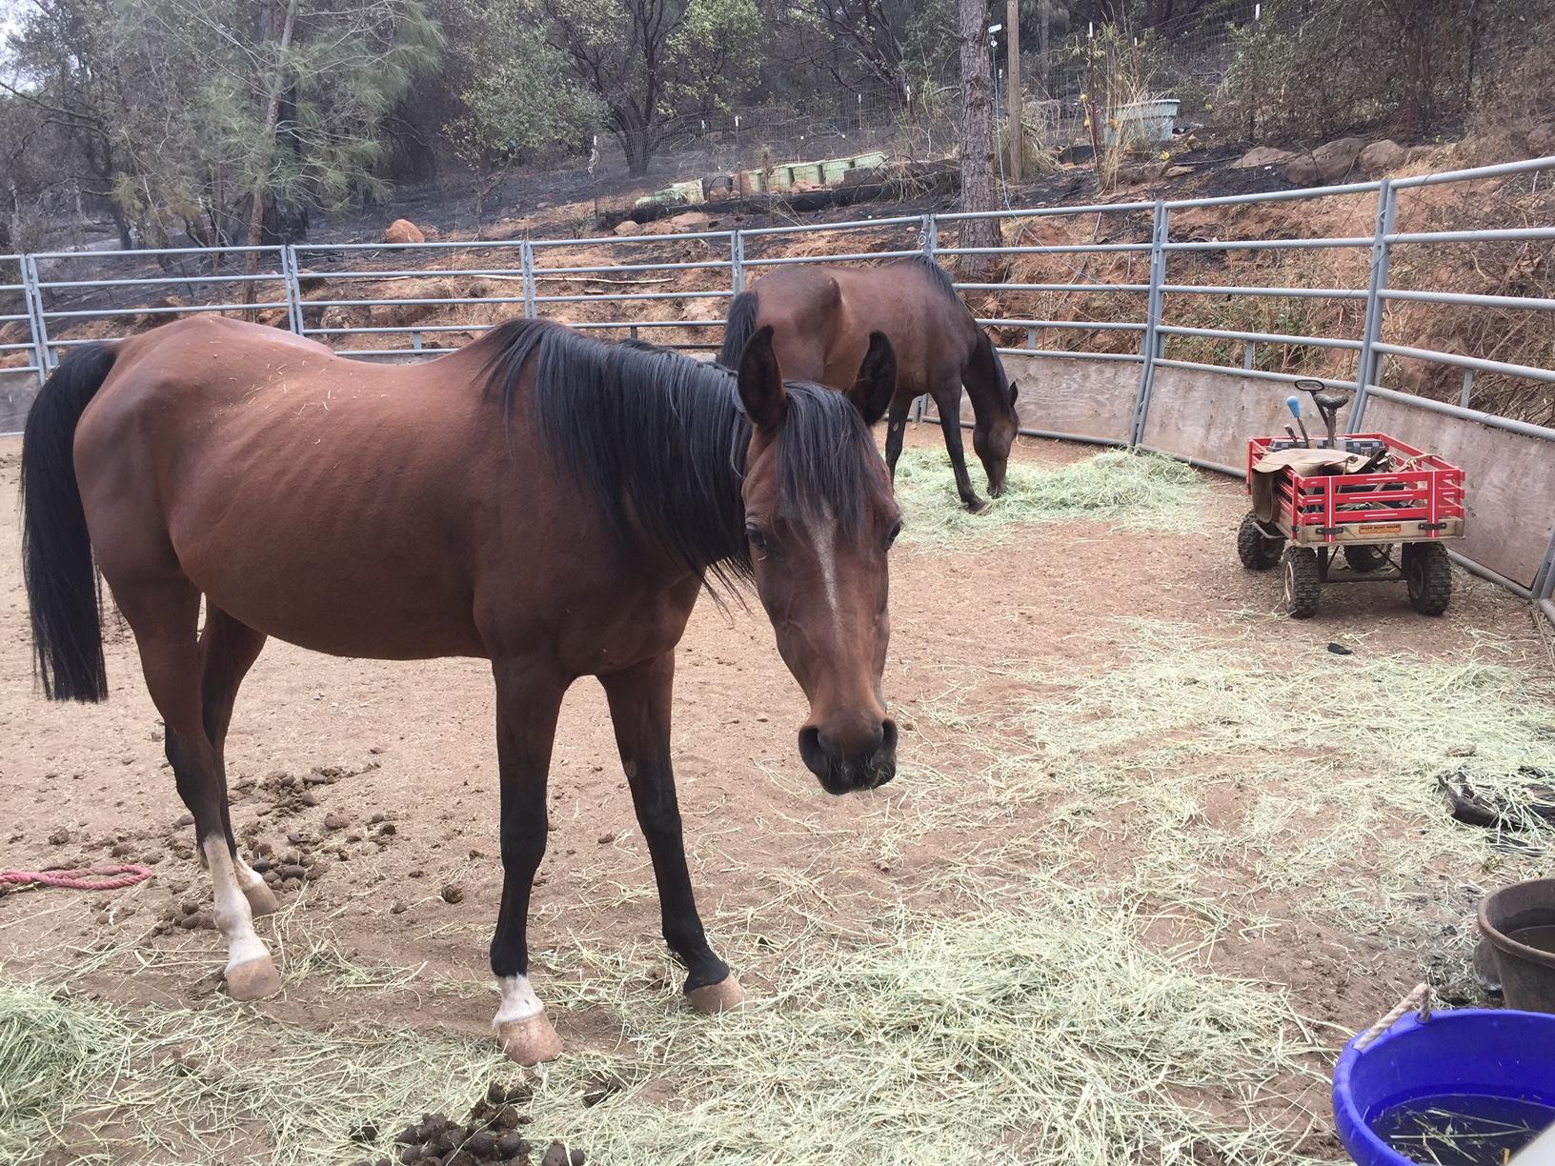
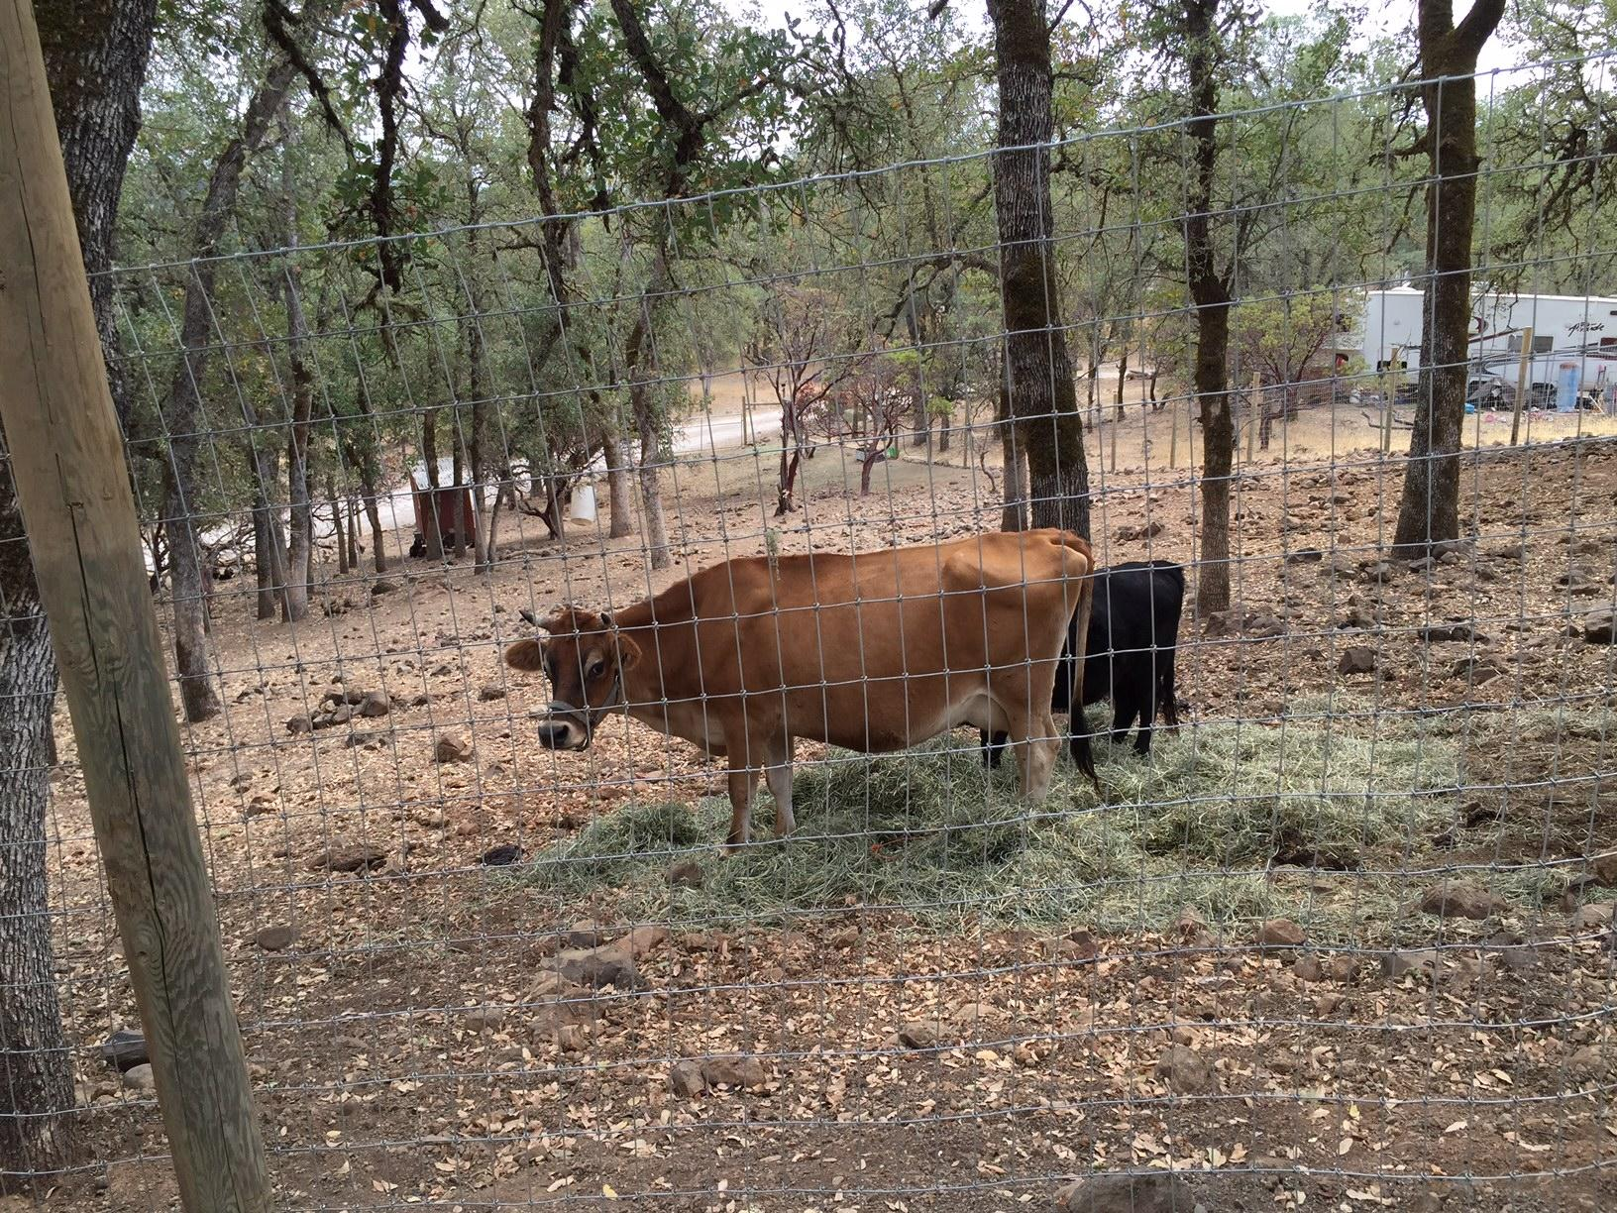
Shelter-In-Place Procedures
Evaluate health and condition of animals
Leave 2 days’ worth of food & water for outside animals - grass hay for horses, ruminants and camelids.
Use animal’s own food if available.
If the RFAS (Request For Animal Services) says an animal should be there but you can’t find it, leave food and water for it anyway. Notify Dispatch of this situation.
Inform Dispatch of continuing care needs.

Slide 18
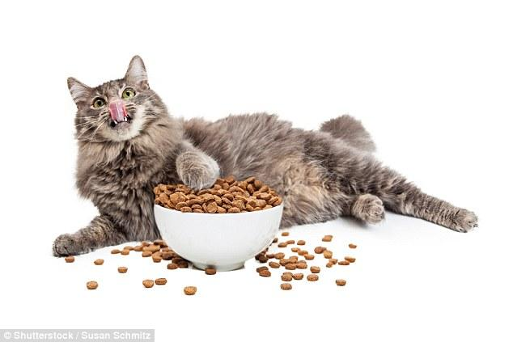
Shelter-In-Place Inside a Home
If entering a home, follow instructions given by Dispatch
Take a partner with you and stay in sight of each other
If animals are inside the house, don’t let them out!
Leave toilet seat up (as water source)
Feed animals’ own food, if it is available. (This reduces risk for digestive issues)
Call Dispatch to record continuing care needs.
Leave SIP Door Hanger displayed in prominent location.

Slide 19
Forms Used in Evac and SIP
If you have evacuated an animal, leave “Evac Door Hanger” or other paperwork to inform owner where the animal(s) have been taken and how to contact Napa CART.
If you choose SIP, Fill out the Animal Care Record
If the decision is made to Shelter In Place, leave SIP Door Hanger and/or SIP Notice Card.
If there is no door, hang it in any prominent location. Tie bright colored tape near it to attract attention.
Mark or attach an identification tag to each animal, whether evacuated or left in SIP
A Log must be kept of all actions performed, as well as any new orders from Dispatch.

Slide 20
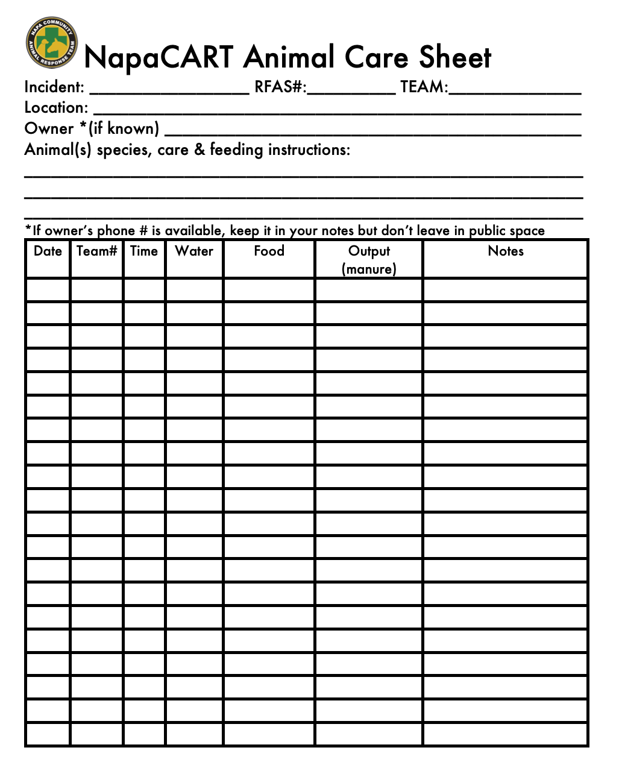
Animal Care Sheet
Use this for every animal in SIP. This record is very important for ensuring consistent care for animals over time, whether they are being cared for while sheltering in place, or evacuated to an emergency shelter.
If a SIP animal is removed to a shelter, take this form with the animal and hand it to the Intake people.

Slide 21
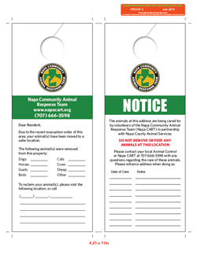
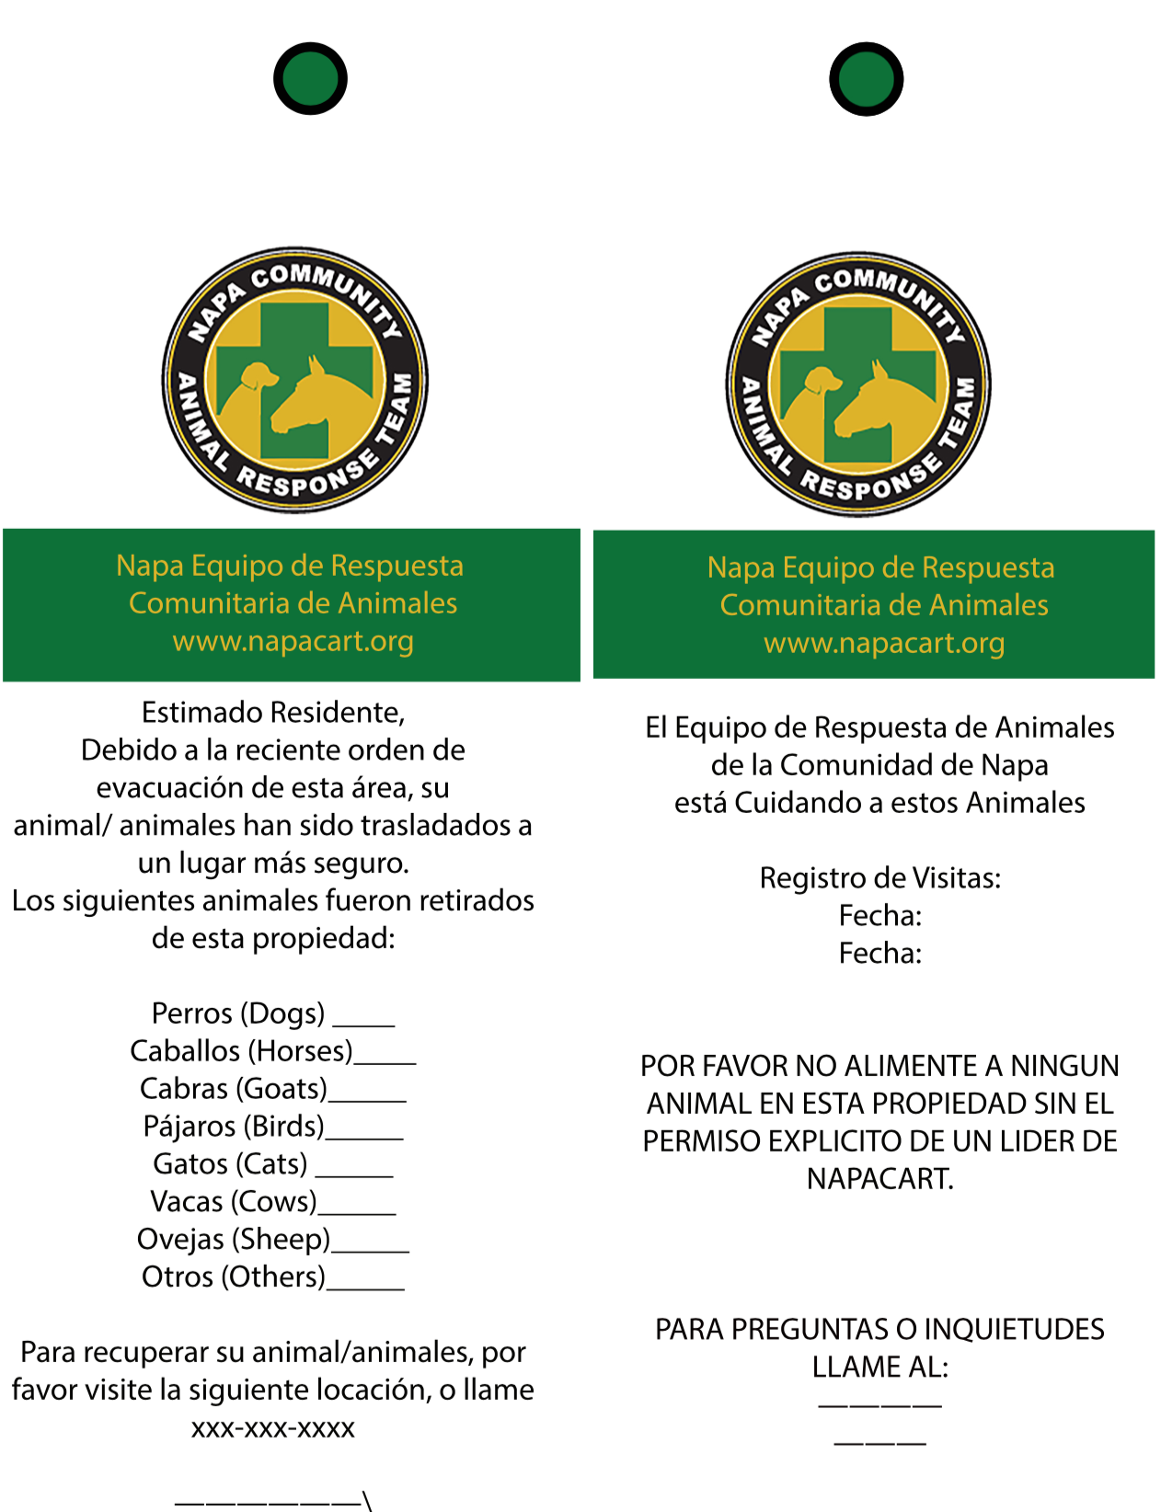
Door Hanger Forms
We have both English and Spanish language Door Hangers

Slide 22
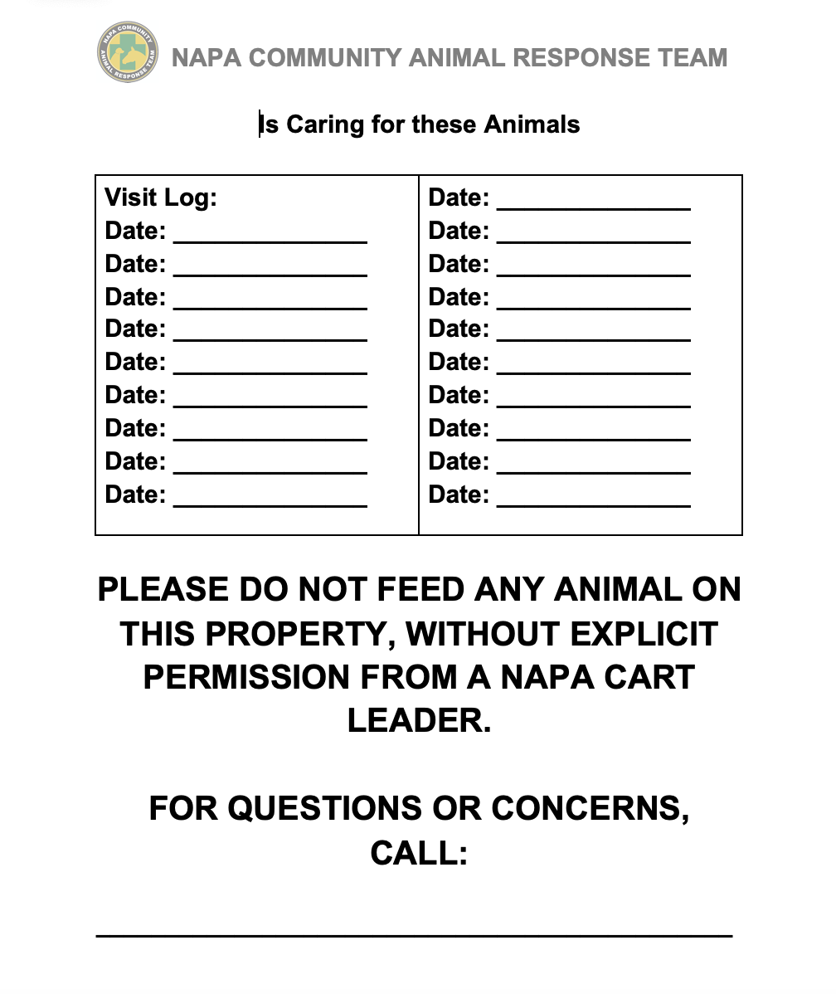
SIP Notice Placard

Slide 23
Legal Self-Protection
Risk: A person may tell Dispatch it is okay to enter their house to save their pets. But later, they can claim that Grandma’s ring is missing and accuse you.
Mitigation:
Your best defense is a witness and a camera. Use your cell phone (or camera or Go-Pro) to take photos of the house’s condition upon entry and upon leaving.
Always go with a buddy.
Leave the scene as you found it. Close any gate or door that you opened.
Always report and document any signs of previous forced entry.
Napa CART requires a background check for sworn-in Disaster Service Workers, to help instill public confidence.

Slide 24
Owner Courtesy Call
After your SIP visit, call the owner with an update on their animals, ask any questions, and log conversation on Animal Care sheet.
Owners are usually very worried about their animals. Your call will give them peace of mind.
If the animals are not fine, the owner still wants to know. If the animal has injuries, the owner should be informed. If the animal has died, the owner deserves closure, painful as this may be.

Slide 25
DECEASED ANIMALS: WHAT TO DO
Sadly, some animals do not survive disasters. If a Team or Scout discovers one or more dead animals:
Photograph the body and note the location on your log.
Notify Dispatch by cell phone or text (not radio - for privacy).
Small carcasses can be bagged in large, heavy-duty plastic yard debris bags and hauled back to Animal Control.
Tag the bag with species, size, color, gender, breed if known, and location (so owner can have closure).
Large Animal carcasses will be removed by Animal Control, but you should call or text the location so Animal Control can find it/them.
Deceased animal information is always confidential!
Notes:
Presenter:

Slide 26
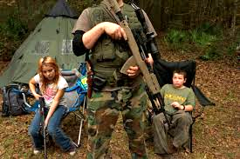
Field Safety Issues
Risk: Evacuated areas are not without people. They may be armed! They may assume you are a looter - or they may be looters themselves.
Mitigation: Travel as a Caravan. Use the amber flashing light on vehicle roof. Wear your Napa CART logo shirt, ID, vest and hat or hard hat. Be friendly and stay calm.
Leave or de-escalate situation to best of your ability.
Notes:
* Magnetic signs might be stolen by people wanting to gain unauthorized entry

Slide 28
“Take Your Time and Hurry”
Despite pressure to hurry, take the time to do it right.
Before leaving a scene, take a deep breath, huddle with team mates, and make sure:
Every gate or door that you opened has been closed properly. If you found it locked, lock it when you leave.
Keys (if used per owner’s instructions) are replaced where you found them.
Most importantly:
Make sure captured animals (including those in a crate) are now physically present in your vehicle; Don’t leave any crated or captured animal behind!
Under stress, short term memory can fail you. Actually go check!
Team should stop to review assignment before leaving.

Slide 29
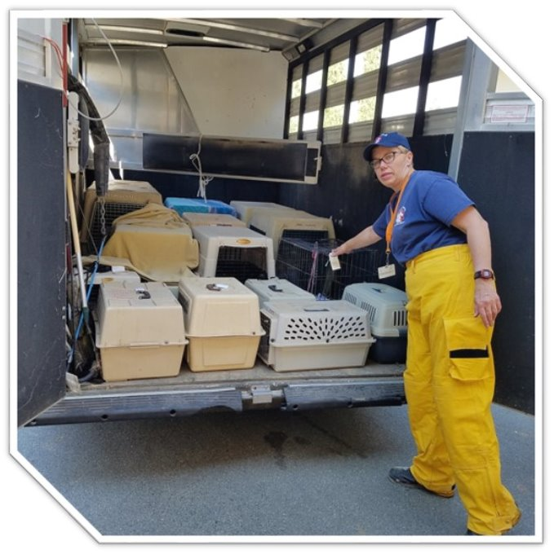
The “Lily Pad” Operation
When time is of the essence and there are many animals needing help, a “Lily Pad” Operation may be used.
In this operation, one trailer waits at the police/fire barricade, while others go into the affected areas to pick up animals.
When a rig returns, the Field driver takes the fresh trailer and the waiting driver takes the full trailer back to the shelter. This saves time, because the Field team does not have to keep going through the barricade and navigating traffic back to the shelter.
Or, In the case of this lily pad operation for small animals, teams bring animals to a large transport trailer, then immediately return to the field for more. The transport trailer goes back to the shelter when it has a full load, and a new one takes its place at the barricade.
Notes:
Estimated COmpletion TIme: 1 hour (if all videos watched)

Slide 30
Heading Back
Always notify Dispatch whenever you are arriving at or leaving a scene.
Dispatch will tell you which shelter to take evacuated animals.
If you cared for SIP animals, tell Dispatch what is necessary to arrange for continuing care.
You may want to attach “Animal Care Record” Form to the RFAS.
Whenever bringing animals in, call the Shelter to inform them how many animals and what species you are bringing back.
Notes:
Presenter: Vicki

Slide 31
When You Get Back
Follow Shelter Intake’s directions.
Unload the animals where the shelter people direct you.
Make sure Shelter receives RFAS and any other relevant paperwork with animal information on it.
Inventory and replenish any essential supplies and equipment.
Disinfect trailer if needed (If done for the day, OR if an animal in last load is sick).​
Tell Dispatch you are ready for new assignment

Slide 32
Finishing Up For The Day
Any checked-out equipment, including radios, must be checked back in - AFTER you have cleaned it. (Wipe it down with Clorox Disinfectant wipes or similar)
Ideally, fresh Ground Crews will be deployed for the next procedures, but regardless:
Thoroughly clean and disinfect trailers and tools.
Make sure supplies are replenished.
Place order for new supplies with Field Ops Leader;
Leader will send order to Shelter Lead, who will place one daily order (one only) through Procurement.

Slide 33
Shift Hand-Off
Inform incoming people what you have done, any issues they need to be aware of, and what they need to continue doing.
Make sure Dispatch knows of all animals needing continuing SIP care.
The Goal of hand-off is continuity of service and continuity of care for the animals.

Slide 34
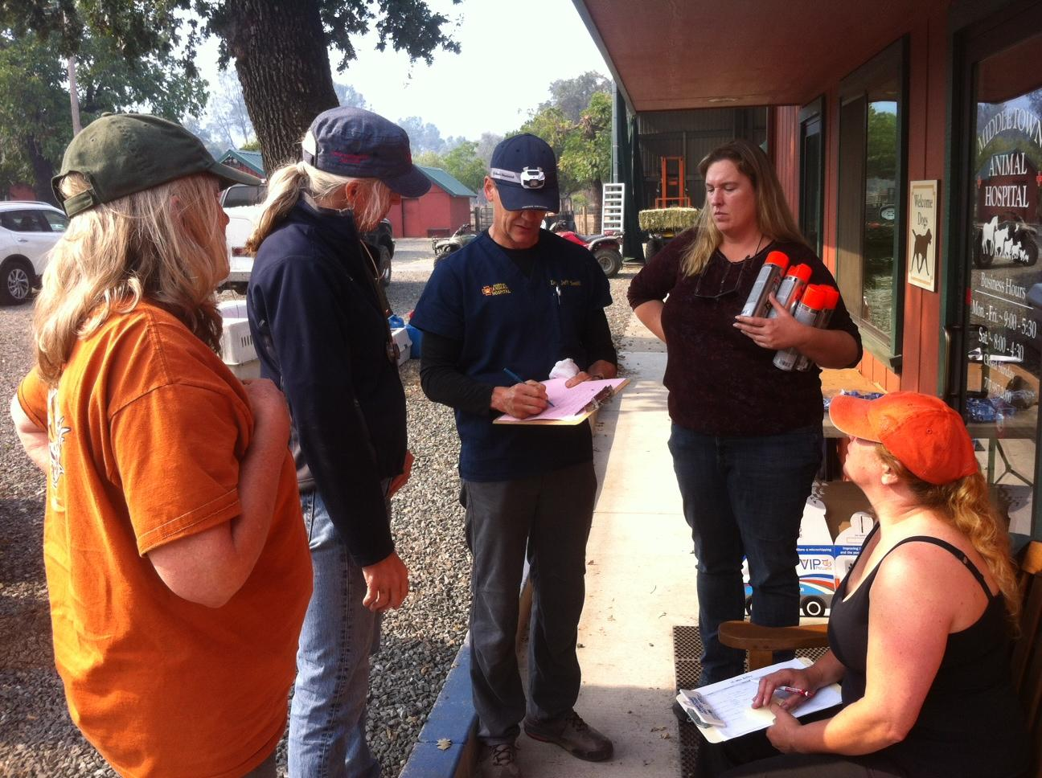
Before Going Home:
Debrief with team mates
Hand-off relevant info to incoming (or tomorrow’s) crew.
Sign Out. Make sure time on sign out matches your 214.
Turn in 214 and Mileage Form.
Shower and change clothes before going home & handling own animals.
When you get home, wash and dry your clothes and and halters, leashes, ropes, towels, etc. used.

Slide 35
Ready to Put it All Together?
Up Next: Table Top Scenarios

Slide 36
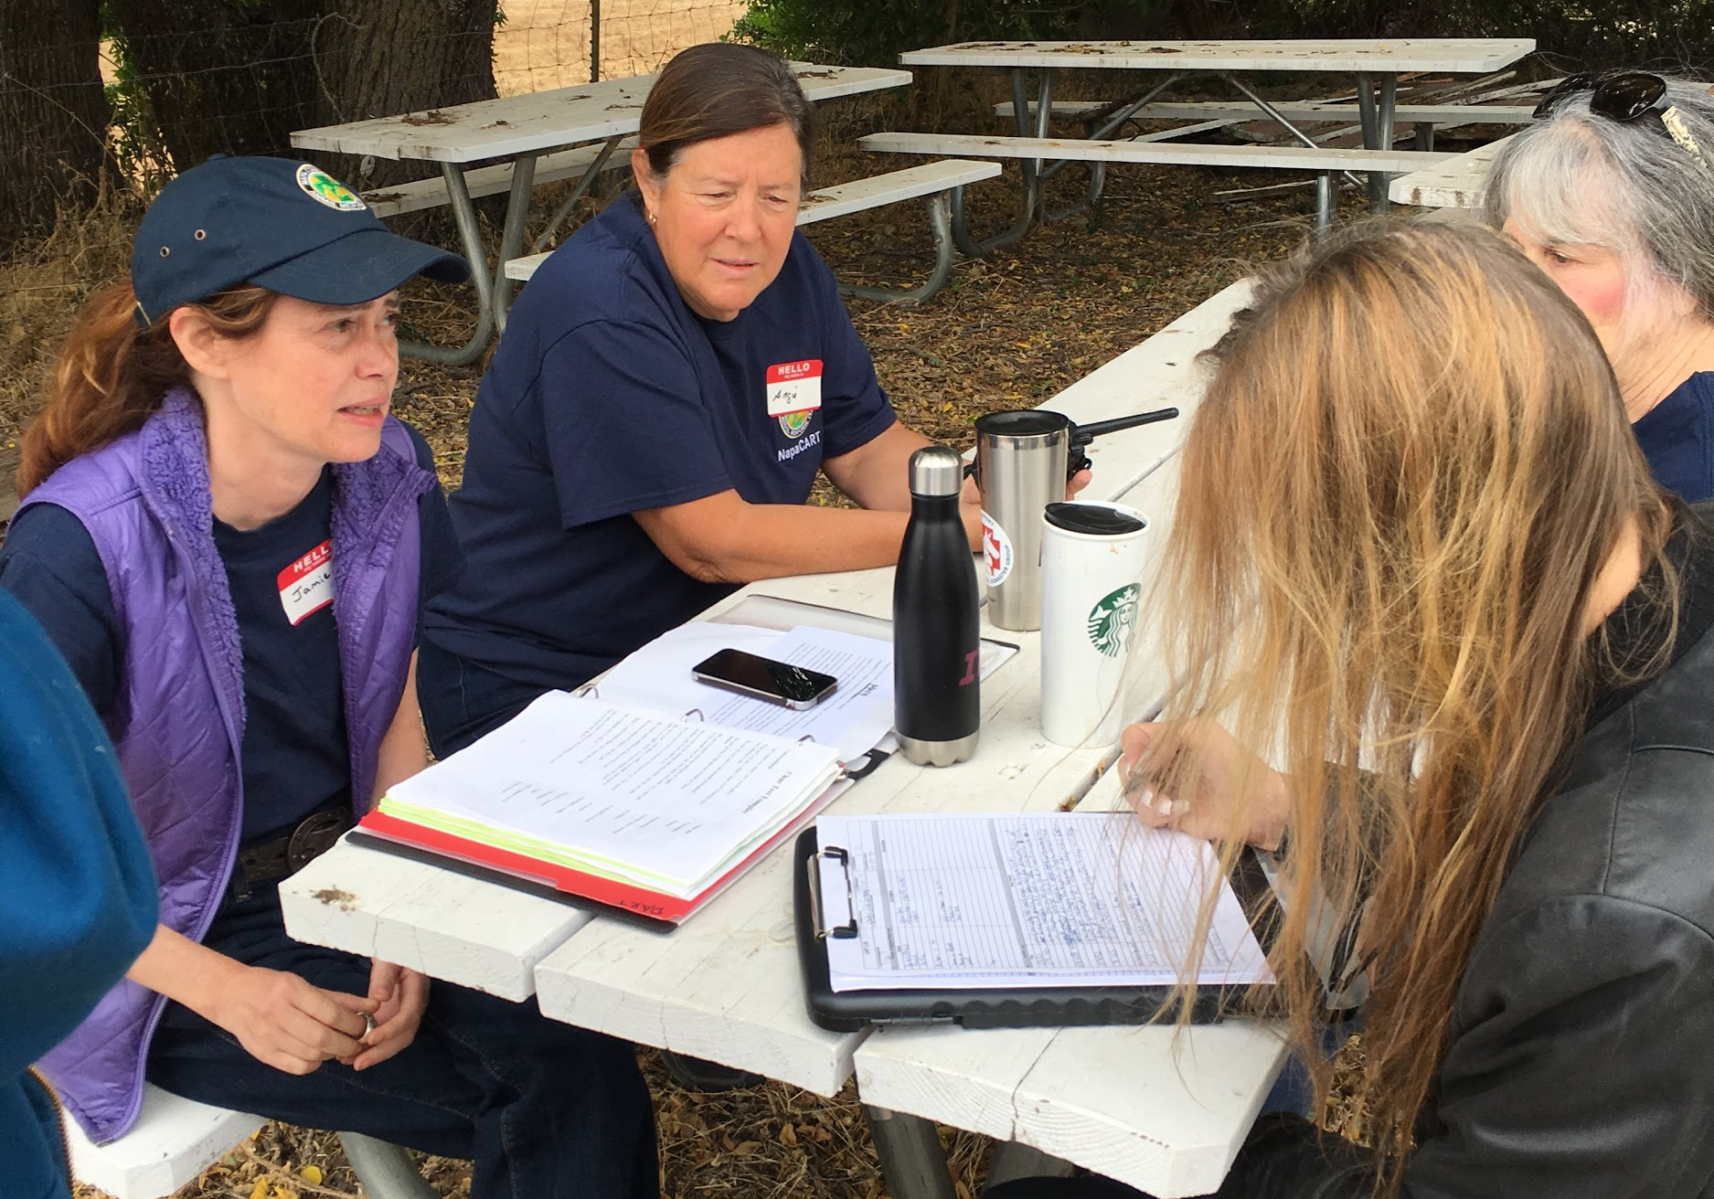
ASAR Home Study #7: Tabletop Scenarios
Notes:
Estimated Completion TIme: 1.5 hours

Slide 37
Your Assignment:
Read Scenarios 1-4.
Think about what is involved with each one and how you might respond.
Choose one scenario and write out a detailed Action Plan.
Send to nancy@napacart.org

Slide 38
Scenario #1
Police dog training facility is damaged by last night’s earthquake; 2 dogs are missing (may be trapped under debris), 5 are still in kennels with no food or water, 4 have been seen running loose. Cell and radio signals are okay.
Road access is unknown, with some significant road damage reported in the area, but there has not yet been time to do a full assessment of road conditions. ______________________________________________________
What does your team need to consider in making a plan to help these animals? (List at least 5 things)
Write or draw out a Plan A and a Plan B for this scenario.

Slide 39
Scenario#2
You are on a 2-person team, driving a club cab pickup truck with a 3-horse trailer. In the bed of your truck you have 2 bales of grass hay, 2 bags of dog food, 4 bags of cat food, a 10 gallon water jug, and 2 large pet carriers. You have a radio and cell phone, both with good signal, and your team kit.
You are sent to an address in a warm zone. The owner states he was at work when the fire broke out and could not go back to get his 3 horses and 2 cats. When you arrive at the property you find 2 horses and one cat. One horse seems to be labored in its breathing. While parked, two donkeys show up and start nibbling at the hay in your truck.
Write out a plan for each animal.

Slide 40
Scenario #3
A household is requesting help, as their street has been placed under Mandatory Evacuation due to a wildfire that could reach them. Fire is in the hills several miles away and is advancing slowly at this time. Wind shift could alter situation.
The property has 2 horses, 2 donkeys, 4 geese, and 1 mother and baby alpaca.
______________________________________________________
List the first 5 considerations that come to your mind.
Write out a Plan A and a Plan B for how your team could handle this scenario.

Slide 41
Scenario #4
Situation: Home has 2 mama goats with 6 nursing kids between them, and 2 newly-adopted BLM (wild) horses. 1 horse can be haltered and knows the basics of leading, the other has just started to allow touching. Fire is expected to hit this area within hours and no safe, fuel-free shelter-in-place location is available. You are assigned a team with a pilot-car/small pickup truck that is also loaded with feed and supplies, a pickup truck pulling a 16’ stock trailer, and a pickup truck pulling a 3 horse slant-load horse trailer.
_____________________________________________________
What considerations do you see here?
Can you evacuate?
What resources do you need?
Write out a plan for each species (goats, horses)

Slide 42
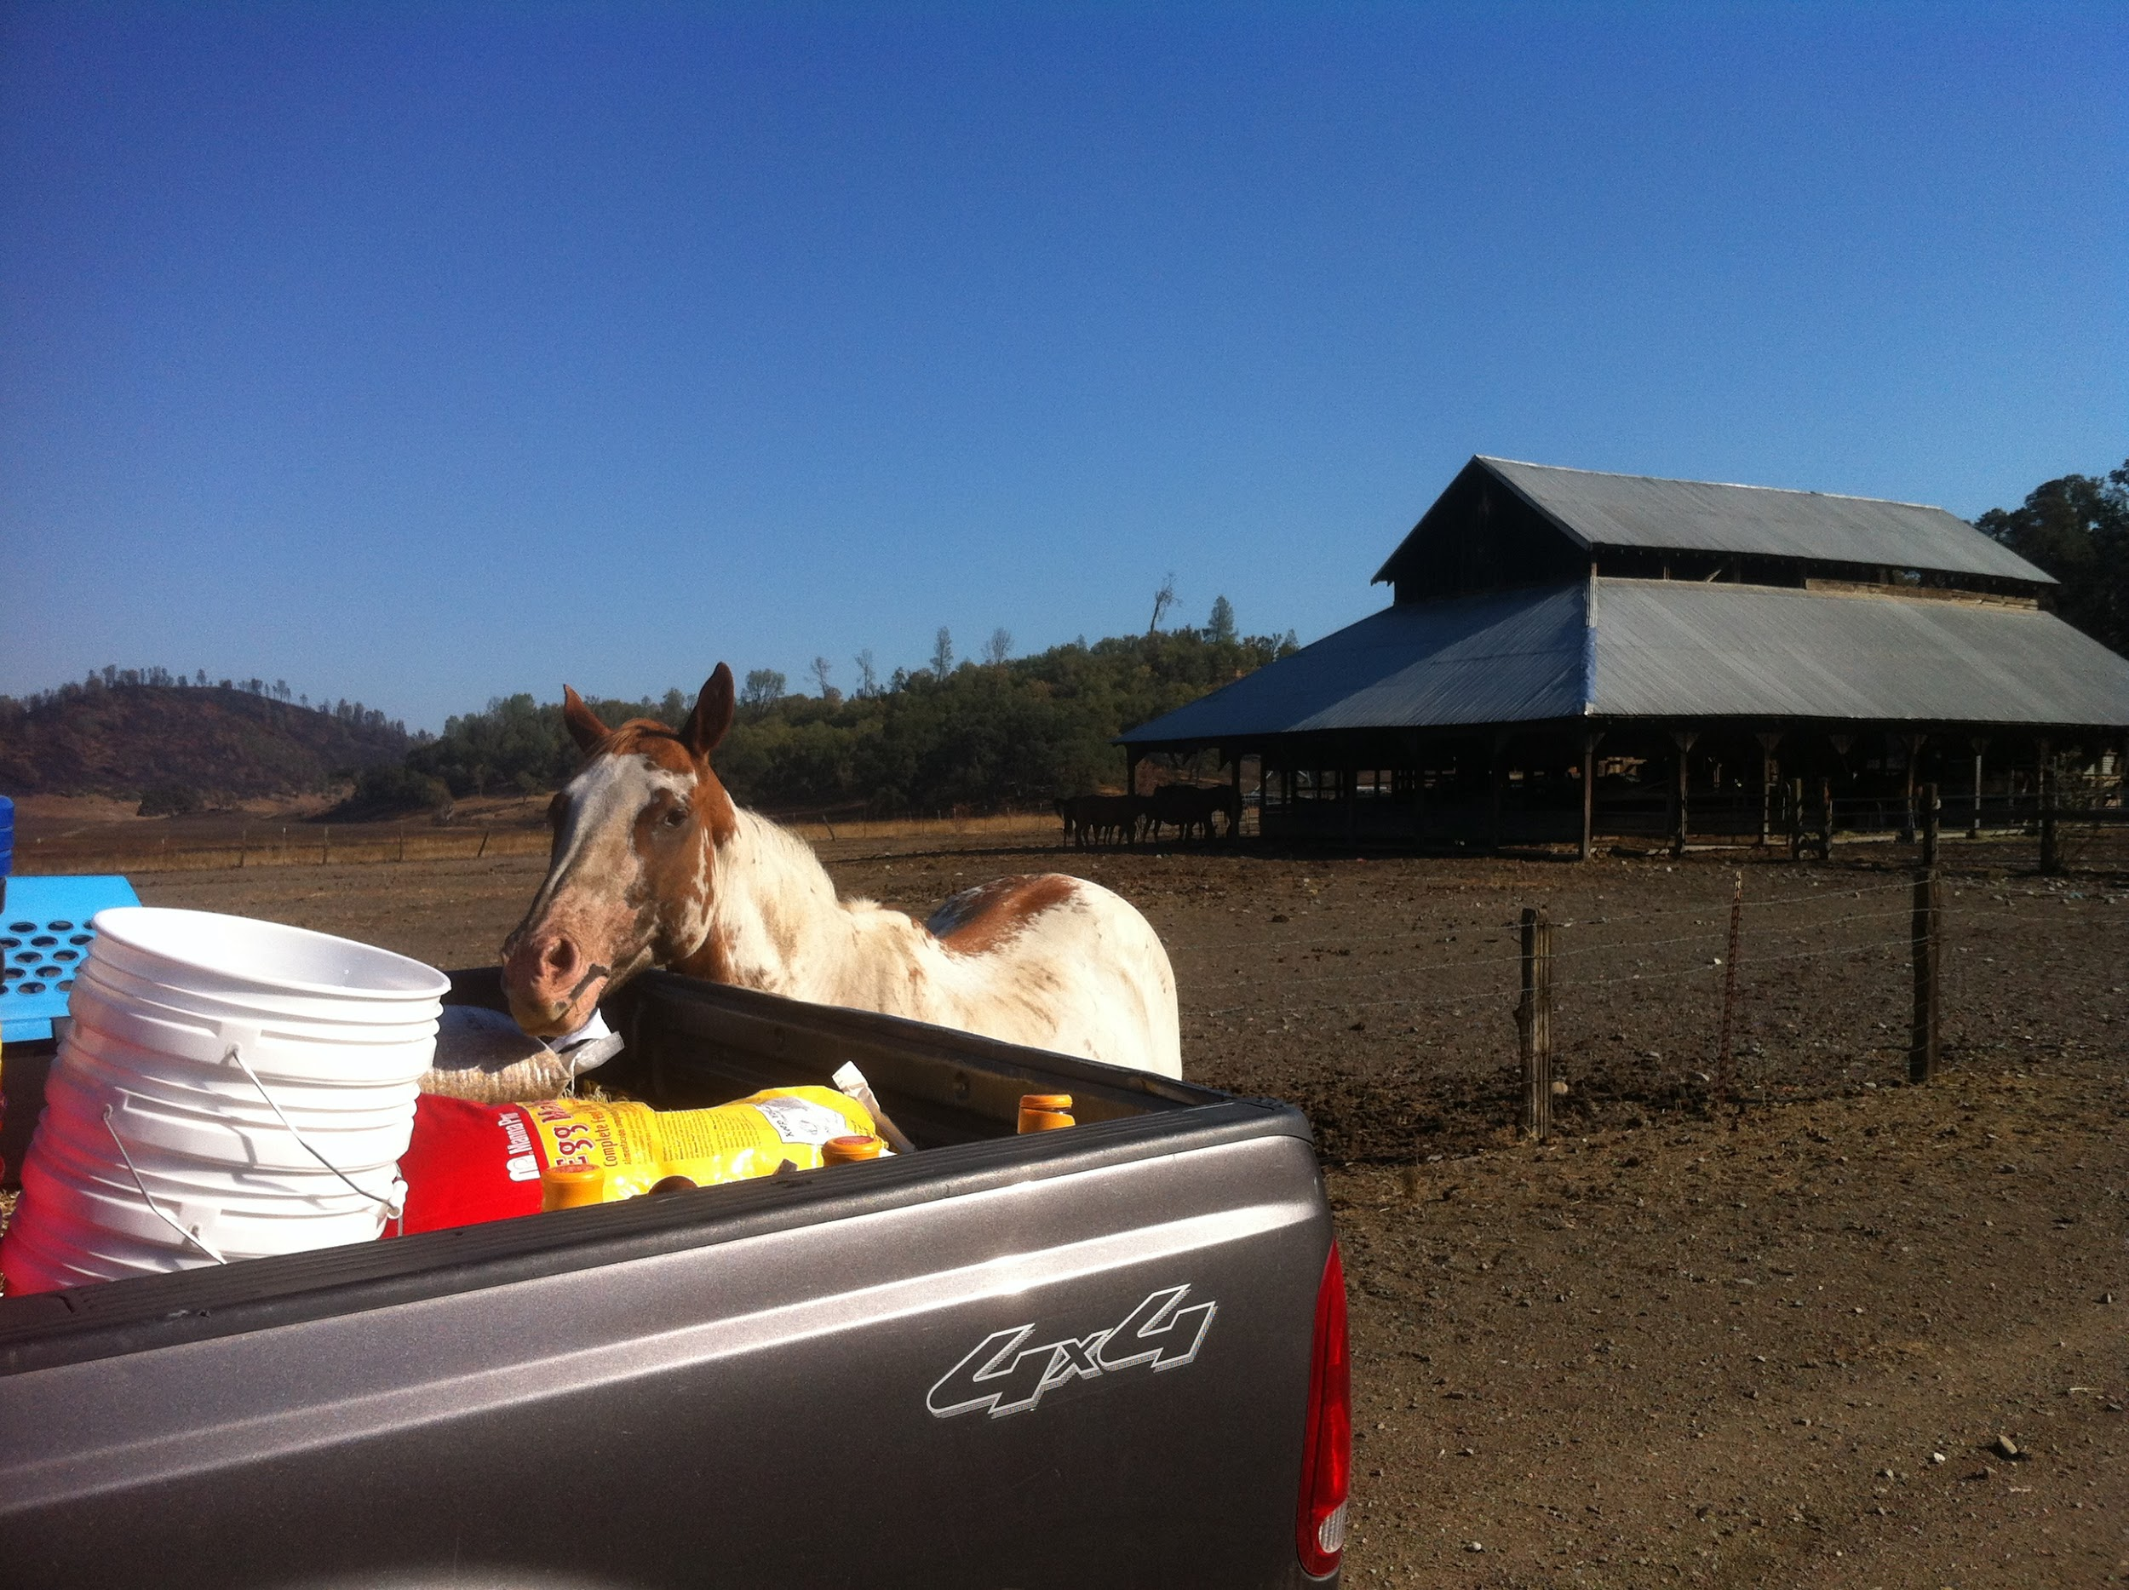
Thanks for Volunteering with NapaCART ASAR!

